Slide 1
Kubernetes
Kubernetes Up & Running
Part I
2026.08.25

Slide 2
Introduction

Slide 3
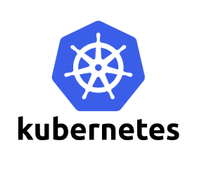
Introduction
Reliable, Scalable, Distributed Systems :
  Kubernetes is an open source orchestrator for deploying containerized applications. It was originally developed by Google, inspired by a decade of experience deploying “scalable, reliable systems” in containers via application-oriented APIs. Since its introduction in 2014, Kubernetes has grown to be one of the largest and most popular open source projects in the world. It has become the standard API for building cloud-native applications, present in nearly every public cloud.
  Kubernetes is a proven infrastructure for distributed systems that is suitable for cloud-native developers of all scales, from a cluster of Raspberry Pi computers to a warehouse full of the latest machines. It provides the software necessary to successfully build and deploy reliable, scalable distributed systems.
  You may be wondering what we mean when we say “reliable, scalable distributed systems.” More and more services are delivered over the network via APIs. These APIs are often delivered by a distributed system, the various pieces that implement the API running on different machines, connected via the network and coordinating their actions via network communication. Because we rely on these APIs increasingly for all aspects of our daily lives (e.g., finding directions to the nearest hospital), these systems must be highly reliable. They cannot fail, even if a part of the system crashes or otherwise stops working. Likewise, they must maintain availability even during software rollouts or other maintenance events. Finally, because more and more of the world is coming online and using such services, they must be highly scalable so that they can grow their capacity to keep up with ever-increasing usage without radical redesign of the distributed system that implements the services.

Slide 4

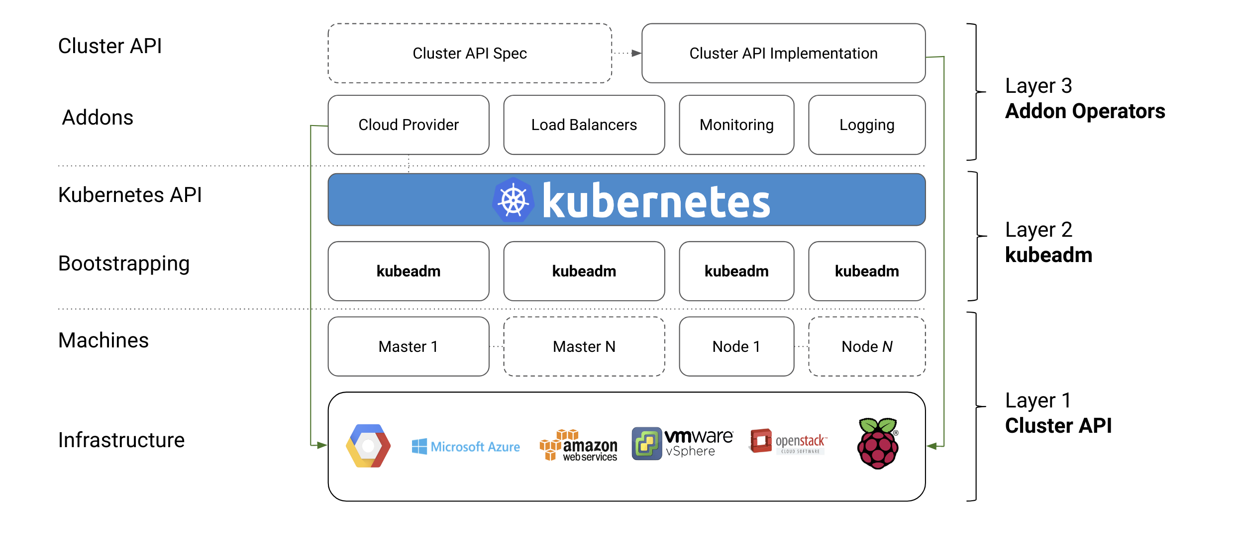
Features(1/21)
Velocity :
  Velocity is the key component in nearly all software development today. The software industry has evolved from shipping products as boxed CDs or DVDs to software that is delivered over the network via web-based services that are updated hourly. This changing landscape means that the difference between you and your competitors is often the speed with which you can develop and deploy new components and features, or the speed with which you can respond to innovations developed by others.
  It is important to note, however, that velocity is not defined in terms of simply raw speed. While your users are always looking for iterative improvement, they are more interested in a highly reliable service. Once upon a time, it was OK for a service to be down for maintenance at midnight every night. But today, all users expect constant uptime, even if the software they are running is changing constantly.
  NOTICE!!! Velocity is measured not in terms of the raw number of features you can ship per hour or day, but rather in terms of the number of things you can ship while maintaining a highly available service.

Slide 5
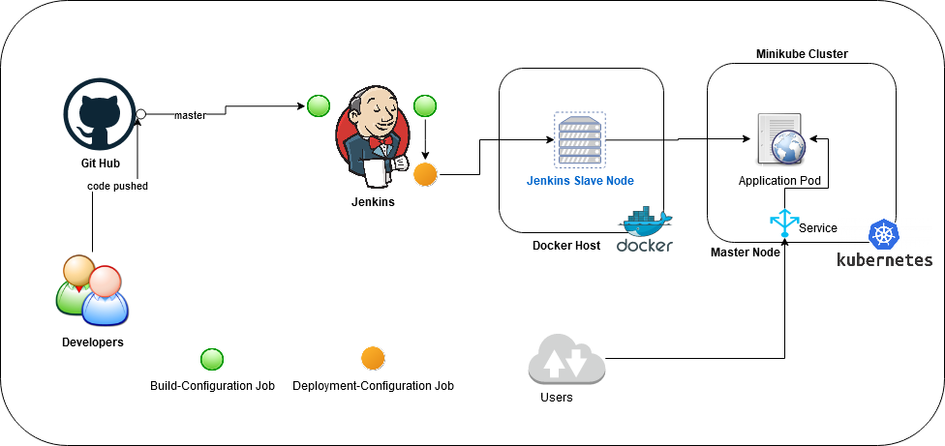
Features(2/21)
Velocity :
  Containers and Kubernetes can provide the tools that you need to move quickly, while staying available. The core concepts that enable this are :
    Immutability
    Declarative configuration
    Online self-healing systems
  These ideas all interrelate to radically improve the speed with which you can reliably deploy software.

Slide 6
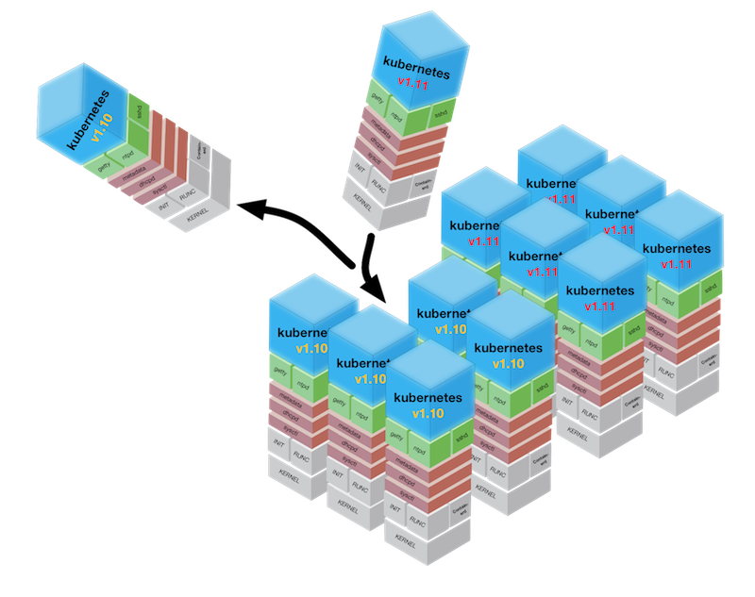
Features(3/21)
The Value of Immutability :
  Containers and Kubernetes encourage developers to build distributed systems that adhere to the principles of immutable infrastructure. With immutable infrastructure, once an artifact is created in the system it does not change via user modifications.
  Traditionally, computers and software systems have been treated as mutable infrastructure. With mutable infrastructure, changes are applied as incremental updates to an existing system. These updates can occur all at once, or spread out across a long period of time. A system upgrade via the “apt-get(Linux Ubuntu)” update tool is a good example of an update to a mutable system. Running “apt” sequentially downloads any updated binaries, copies them on top of older binaries, and makes incremental updates to configuration files.
  With a mutable system, the current state of the infrastructure is not represented as a single artifact, but rather an accumulation of incremental updates and changes over time. On many systems these incremental updates come from not just system upgrades, but operator modifications as well. Furthermore, in any system run by a large team, it is highly likely that these changes will have been performed by many different people, and in many cases will not have been recorded anywhere.
  In contrast, in an immutable system, rather than a series of incremental updates and changes, an entirely new, complete image is built, where the update simply replaces the entire image with the newer image in a single operation. There are no incremental changes.

Slide 7
Features(4/21)
The Value of Immutability :
  To make this more concrete in the world of containers, consider two different ways to upgrade your software :
    You can log in to a container, run a command to download your new software, kill the old server, and start the new one.
    You can build a new container image, push it to a container registry, kill the existing container, and start a new one.
  The key differentiation is the artifact that you create, and the record of how you created it. These records make it easy to understand exactly the differences in some new version and, if something goes wrong, to determine what has changed and how to fix it.
  Building a new image rather than modifying an existing one means the old image is still around, and can quickly be used for a rollback if an error occurs. In contrast, once you copy your new binary over an existing binary, such a rollback is nearly impossible.
  Immutable container images are at the core of everything that you will build in Kubernetes. It is possible to imperatively change running containers, but this is an anti-pattern to be used only in extreme cases where there are no other options (e.g., if it is the only way to temporarily repair a mission-critical production system). And even then, the changes must also be recorded through a declarative configuration update at some later time, after the fire is out.

Slide 8
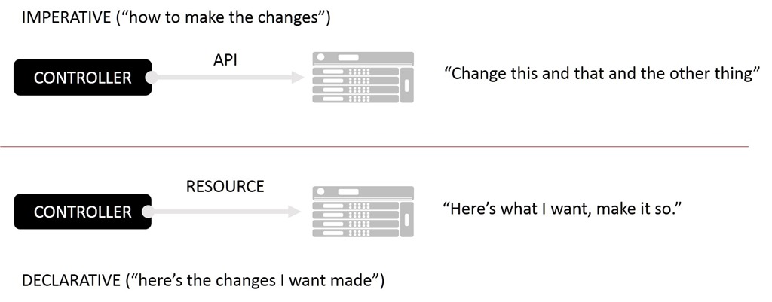
Features(5/21)
Declarative Configuration :
  Immutability extends beyond containers running in your cluster to the way you describe your application to Kubernetes. Everything in Kubernetes is a declarative configuration object that represents the desired state of the system. It is the job of Kubernetes to ensure that the actual state of the world matches this desired state.
  Much like mutable versus immutable infrastructure, declarative configuration is an alternative to imperative configuration, where the state of the world is defined by the execution of a series of instructions rather than a declaration of the desired state of the world. While imperative commands define actions, declarative configurations define state.
  To understand these two approaches, consider the task of producing three replicas of a piece of software. With an imperative approach, the configuration would say “run A, run B, and run C.” The corresponding declarative configuration would be “replicas equals three.”

Slide 9
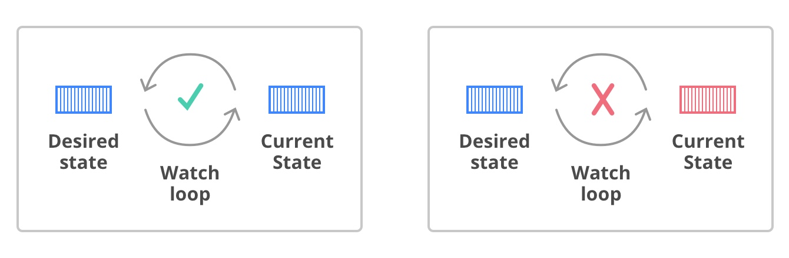
Features(6/21)
Declarative Configuration :
  Because it describes the state of the world, declarative configuration does not have to be executed to be understood. Its impact is concretely declared. Since the effects of declarative configuration can be understood before they are executed, declarative configuration is far less error-prone. Further, the traditional tools of software development, such as source control, code review, and unit testing, can be used in declarative configuration in ways that are impossible for imperative instructions. The idea of storing declarative configuration in source control is often referred to as “infrastructure as code.”
  The combination of declarative state stored in a version control system and the ability of Kubernetes to make reality match this declarative state makes rollback of a change trivially easy. It is simply restating the previous declarative state of the system. This is usually impossible with imperative systems, because although the imperative instructions describe how to get you from point A to point B, they rarely include the reverse instructions that can get you back.

Slide 10
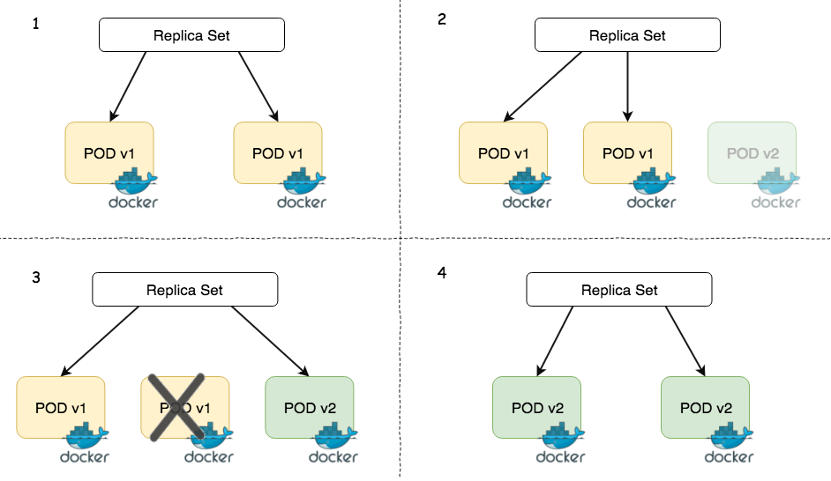
Features(7/21)
Self-Healing Systems :
  Kubernetes is an online, self-healing system. When it receives a desired state configuration, it does not simply take a set of actions to make the current state match the desired state a single time. It continuously takes actions to ensure that the current state matches the desired state. This means that not only will Kubernetes initialize your system, but it will guard it against any failures or perturbations that might destabilize the system and affect reliability.
  A more traditional operator repair involves a manual series of mitigation steps, or human intervention performed in response to some sort of alert. Imperative repair like this is more expensive (since it generally requires an on-call operator to be available to enact the repair). It is also generally slower, since a human must often wake up and log in to respond. Furthermore, it is less reliable because the imperative series of repair operations suffers from all of the problems of imperative management described in the previous section. Self-healing systems like Kubernetes both reduce the burden on operators and improve the overall reliability of the system by performing reliable repairs more quickly.

Slide 11
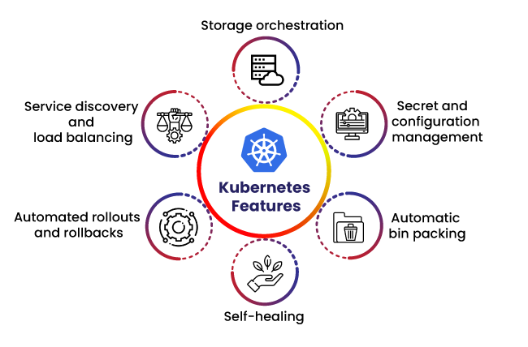
Features(8/21)
Self-Healing Systems :
  Online self-healing systems improve developer velocity because the time and energy you might otherwise have spent on operations and maintenance can instead be spent on developing and testing new features.
  In a more advanced form of self-healing, there has been significant recent work in the operator paradigm for Kubernetes. With operators, more advanced logic needed to maintain, scale, and heal a specific piece of software (MySQL, for example) is encoded into an operator application that runs as a container in the cluster. The code in the operator is responsible for more targeted and advanced health detection and healing than can be achieved via Kubernetes’s generic self-healing. Often this is packaged up as “operators”.

Slide 12
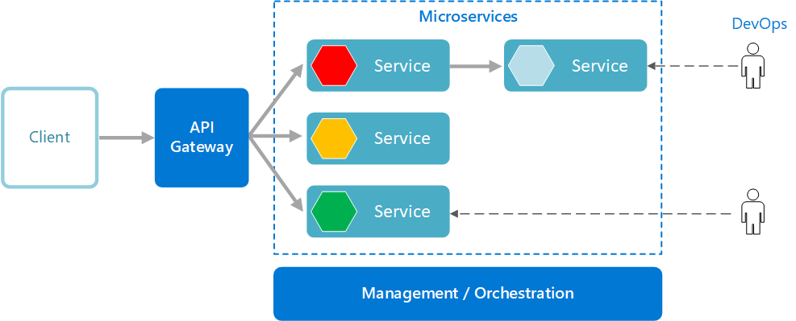
Features(9/21)
Scaling Your Service and Your Teams :
  As your product grows, it’s inevitable that you will need to scale both your software and the teams that develop it. Fortunately, Kubernetes can help with both of these goals. Kubernetes achieves scalability by favoring decoupled architectures.
Decoupling :
  In a decoupled architecture, each component is separated from other components by defined APIs and service load balancers. APIs and load balancers isolate each piece of the system from the others. APIs provide a buffer between implementer and consumer, and load balancers provide a buffer between running instances of each service.
  Decoupling components via load balancers makes it easy to scale the programs that make up your service, because increasing the size (and therefore the capacity) of the program can be done without adjusting or reconfiguring any of the other layers of your service.
  Decoupling servers via APIs makes it easier to scale the development teams because each team can focus on a single, smaller microservice with a comprehensible surface area. Crisp APIs between microservices limit the amount of cross-team communication overhead required to build and deploy software. This communication overhead is often the major restricting factor when scaling teams.

Slide 13
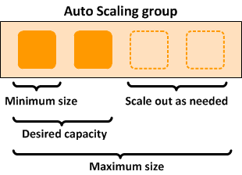
Features(10/21)
Easy Scaling for Applications and Clusters :
  When you need to scale your service, the immutable, declarative nature of Kubernetes makes this scaling trivial to implement. Because your containers are immutable, and the number of replicas is merely a number in a declarative config, scaling your service upward is simply a matter of changing a number in a configuration file, asserting this new declarative state to Kubernetes, and letting it take care of the rest. Alternatively, you can set up autoscaling and let Kubernetes take care of it for you.
  Of course, that sort of scaling assumes that there are resources available in your cluster to consume. Sometimes you actually need to scale up the cluster itself. Again, Kubernetes makes this task easier. Because many machines in a cluster are entirely identical to other machines in that set and the applications themselves are decoupled from the details of the machine by containers, adding additional resources to the cluster is simply a matter of imaging a new machine of the same class and joining it into the cluster. This can be accomplished via a few simple commands or via a prebaked machine image.

Slide 14
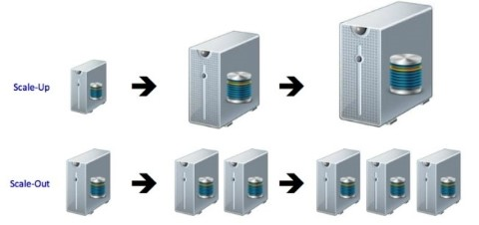
Features(11/21)
Easy Scaling for Applications and Clusters :
  One of the challenges of scaling machine resources is predicting their use. If you are running on physical infrastructure, the time to obtain a new machine is measured in days or weeks. On both physical and cloud infrastructure, predicting future costs is difficult because it is hard to predict the growth and scaling needs of specific applications.
  Kubernetes can simplify forecasting future compute costs. Historically you have seen that each team’s growth is highly variable and thus hard to predict. If you are provisioning individual machines for each service, you have no choice but to forecast based on the maximum expected growth for each service, since machines dedicated to one team cannot be used for another team. If instead you use Kubernetes to decouple the teams from the specific machines they are using, you can forecast growth based on the aggregate growth of all three services. Furthermore, decoupling the teams from specific machines means that teams can share fractional parts of one another’s machines, reducing even further the overheads associated with forecasting growth of computing resources.

Slide 15
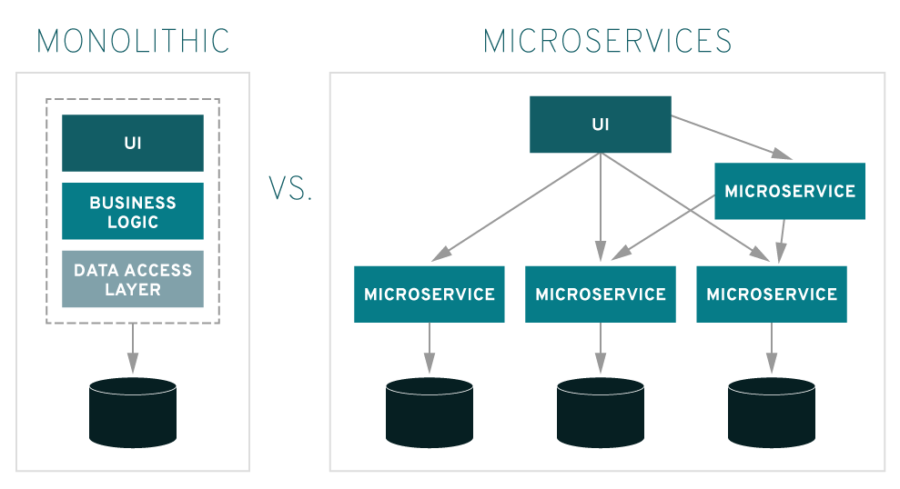
Features(12/21)
Scaling Development Teams with Microservices :
  The ideal team size is the “two-pizza team,” or roughly six to eight people(or 7 ± 2 = 5 ~ 9). This group size often results in good knowledge sharing, fast decision making, and a common sense of purpose. Larger teams tend to suffer from issues of hierarchy, poor visibility, and infighting, which hinder agility and success.
  However, many projects require significantly more resources to be successful and achieve their goals. Consequently, there is a tension between the ideal team size for agility and the necessary team size for the product’s end goals.
  The common solution to this tension has been the development of decoupled, service-oriented teams that each build a single microservice. Each small team is responsible for the design and delivery of a service that is consumed by other small teams. The aggregation of all of these services ultimately provides the implementation of the overall product’s surface area.

Slide 16
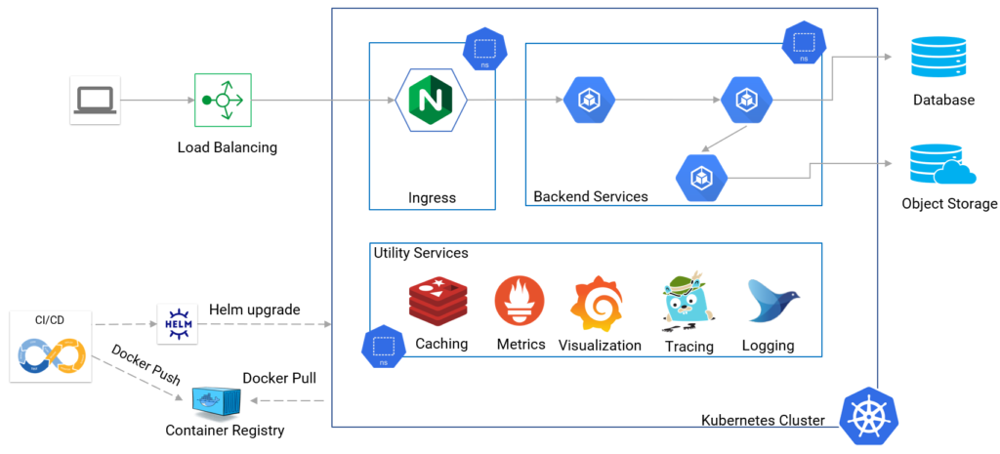
Features(13/21)
Scaling Development Teams with Microservices :
  Kubernetes provides numerous abstractions and APIs that make it easier to build these decoupled microservice architectures :
    Pods, or groups of containers, can group together container images developed by different teams into a single deployable unit.
    Kubernetes services provide load balancing, naming, and discovery to isolate one microservice from another.
    Namespaces provide isolation and access control, so that each microservice can control the degree to which other services interact with it.
    Ingress objects provide an easy-to-use frontend that can combine multiple microservices into a single externalized API surface area.
  Finally, decoupling the application container image and machine means that different microservices can colocate on the same machine without interfering with one another, reducing the overhead and cost of microservice architectures.
  The health-checking and rollout features of Kubernetes guarantee a consistent approach to application rollout and reliability that ensures that a proliferation of microservice teams does not also result in a proliferation of different approaches to service production lifecycle and operations.

Slide 17
Features(14/21)
Separation of Concerns for Consistency and Scaling :
  In addition to the consistency that Kubernetes brings to operations, the decoupling and separation of concerns produced by the Kubernetes stack lead to significantly greater consistency for the lower levels of your infrastructure. This enables you to scale infrastructure operations to manage many machines with a single small, focused team.
  The container orchestration API becomes a crisp contract that separates the responsibilities of the application operator from the cluster orchestration operator. We call this the “not my monkey, not my circus” line. The application developer relies on the service-level agreement (SLA) delivered by the container orchestration API, without worrying about the details of how this SLA is achieved. Likewise, the container orchestration API reliability engineer focuses on delivering the orchestration API’s SLA without worrying about the applications that are running on top of it.

Slide 18
Features(15/21)
Separation of Concerns for Consistency and Scaling :
  The decoupling of concerns means that a small team running a Kubernetes cluster can be responsible for supporting hundreds or even thousands of teams running applications within that cluster. Likewise, a small team can be responsible for dozens (or more) of clusters running around the world. It’s important to note that the same decoupling of containers and OS enables the OS reliability engineers to focus on the SLA of the individual machine’s OS. This becomes another line of separate responsibility, with the Kubernetes operators relying on the OS SLA, and the OS operators worrying solely about delivering that SLA. Again, this enables you to scale a small team of OS experts to a fleet of thousands of machines.
  Devoting even a small team to managing an OS is beyond the scale of many organizations. In these environments, a managed “Kubernetes-as-a-Service (KaaS)” provided by a public cloud provider is a great option. As Kubernetes has become increasingly ubiquitous, KaaS has become increasingly available as well, to the point where it is now offered on nearly every public cloud. Using a KaaS has some limitations, since the operator makes decisions for you about how the Kubernetes clusters are built and configured.

Slide 19
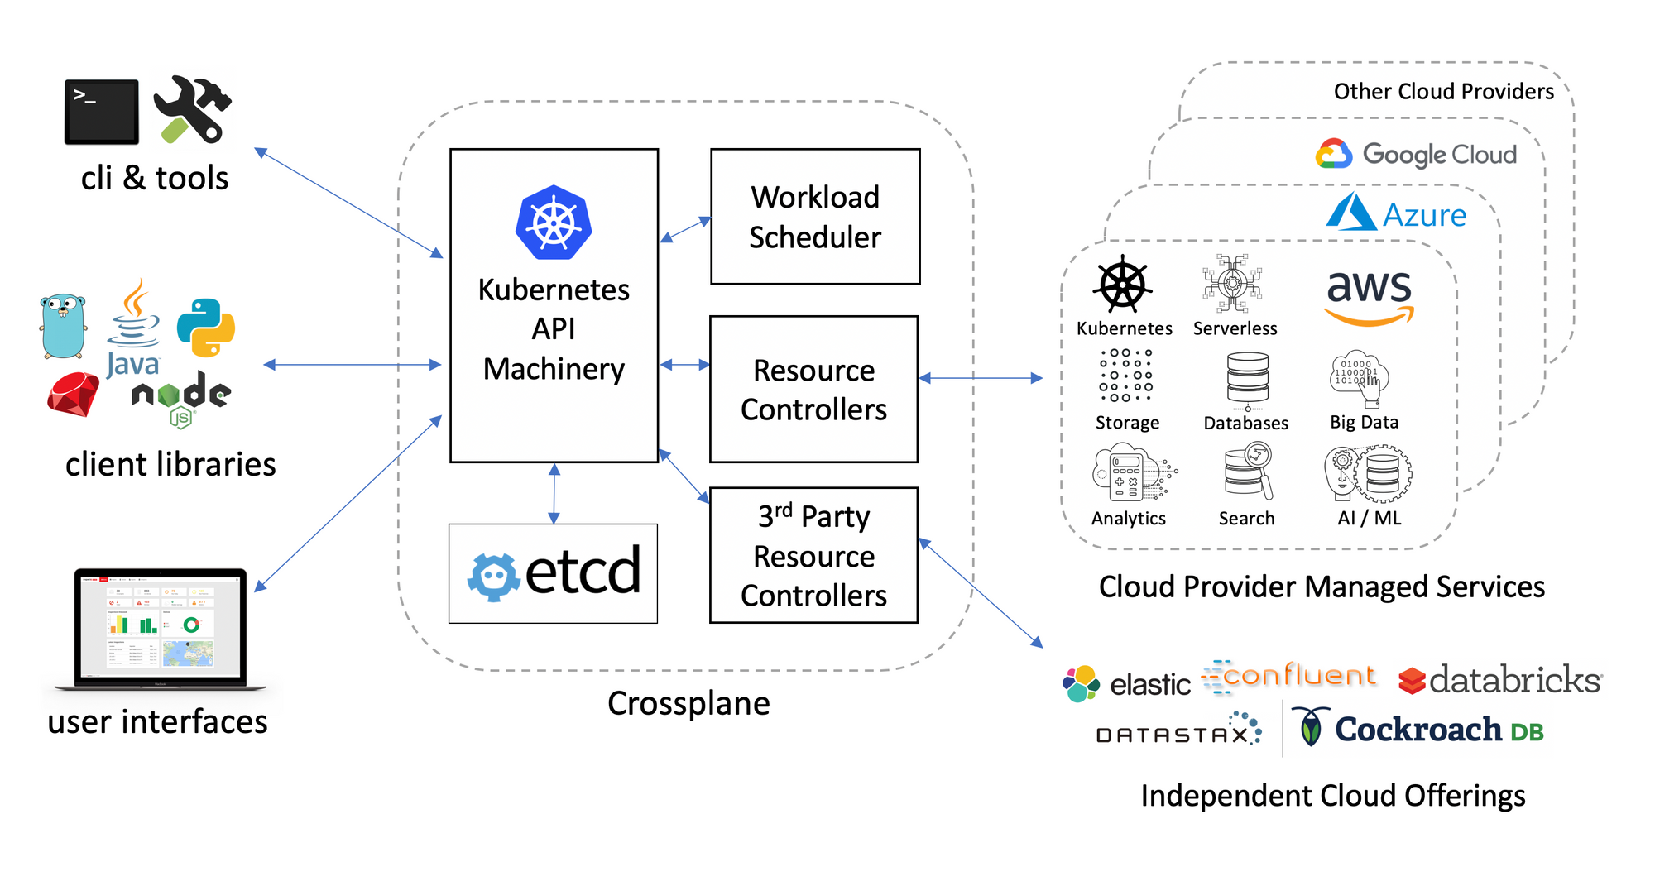
Features(16/21)
Separation of Concerns for Consistency and Scaling :
  In addition to a fully managed Kubernetes service, there is a thriving ecosystem of companies and projects that help to install and manage Kubernetes. There is a full spectrum of solutions between doing it “the hard way” and a fully managed service.
  The decision of whether to use KaaS or manage it yourself (or something in between) is one each user needs to make based on the skills and demands of their situation. Often for small organizations, KaaS provides an easy-to-use solution that enables them to focus their time and energy on building the software to support their work rather than managing a cluster. For a larger organization that can afford a dedicated team for managing its Kubernetes cluster, it may make sense to manage it yourself since it enables greater flexibility in terms of cluster capabilities and operations.

Slide 20
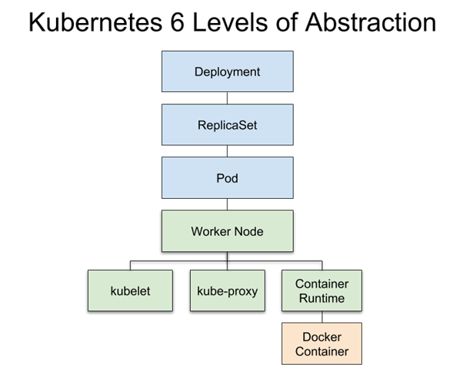
Features(17/21)
Abstracting Your Infrastructure :
  The goal of the public cloud is to provide easy-to-use, self-service infrastructure for developers to consume. However, too often cloud APIs are oriented around mirroring the infrastructure that IT expects, not the concepts (e.g., “virtual machines” instead of “applications”) that developers want to consume. Additionally, in many cases the cloud comes with particular details in implementation or services that are specific to the cloud provider. Consuming these APIs directly makes it difficult to run your application in multiple environments, or spread between cloud and physical environments.
  The move to application-oriented container APIs like Kubernetes has two concrete benefits. First, it separates developers from specific machines. This makes the machine-oriented IT role easier, since machines can simply be added in aggregate to scale the cluster, and in the context of the cloud it also enables a high degree of portability since developers are consuming a higher-level API that is implemented in terms of the specific cloud infrastructure APIs.

Slide 21
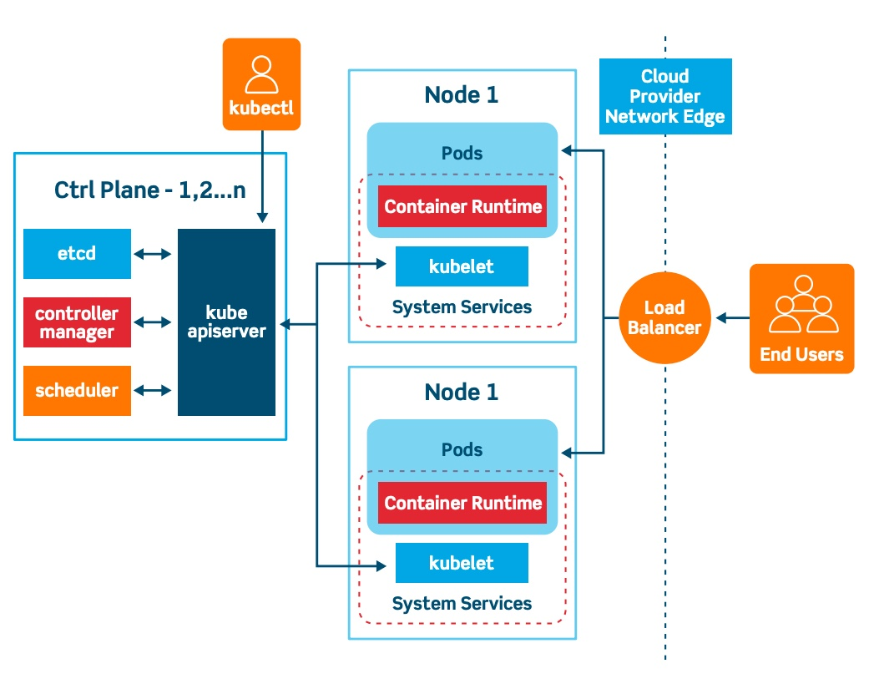
Features(18/21)
Abstracting Your Infrastructure :
  When your developers build their applications in terms of container images and deploy them in terms of portable Kubernetes APIs, transferring your application between environments, or even running in hybrid environments, is simply a matter of sending the declarative config to a new cluster.
  Kubernetes has a number of plug-ins that can abstract you from a particular cloud. For example, Kubernetes services know how to create load balancers on all major public clouds as well as several different private and physical infrastructures. Likewise, Kubernetes PersistentVolumes and PersistentVolumeClaims can be used to abstract your applications away from specific storage implementations.
  To achieve this portability you need to avoid cloud-managed services (e.g., Amazon’s DynamoDB, Azure’s CosmosDB, or Google’s Cloud Spanner), which means that you will be forced to deploy and manage open source storage solutions like Cassandra, MySQL, or MongoDB.
  Putting it all together, building on top of Kubernetes’s application-oriented abstractions ensures that the effort you put into building, deploying, and managing your application is truly portable across a wide variety of environments.

Slide 22
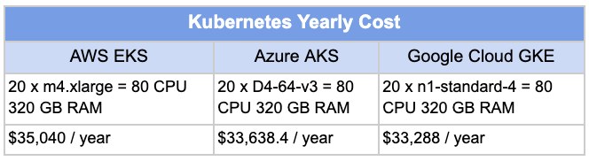
Features(19/21)
Efficiency :
  In addition to the developer and IT management benefits that containers and Kubernetes provide, there is also a concrete economic benefit to the abstraction. Because developers no longer think in terms of machines, their applications can be collocated on the same machines without impacting the applications themselves. This means that tasks from multiple users can be packed tightly onto fewer machines.
  Efficiency can be measured by the ratio of the useful work performed by a machine or process to the total amount of energy spent doing so. When it comes to deploying and managing applications, many of the available tools and processes (e.g., bash scripts, apt updates, or imperative configuration management) are somewhat inefficient. When discussing efficiency it’s often helpful to think of both the cost of running a server and the human cost required to manage it.
https://www.parkmycloud.com/blog/kubernetes-pricing/ 2020.04.03

Slide 23
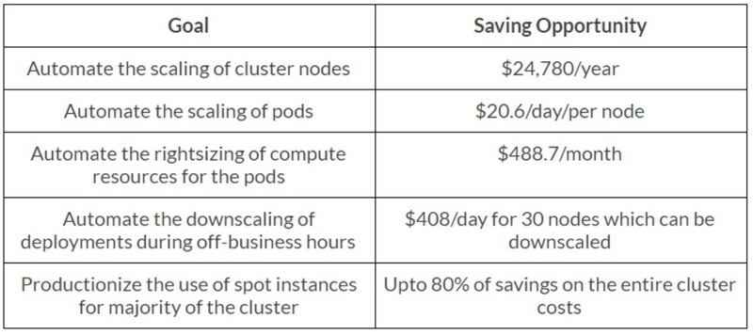
Features(20/21)
Efficiency :
  Running a server incurs a cost based on power usage, cooling requirements, datacenter space, and raw compute power. Once a server is racked and powered on (or clicked and spun up), the meter literally starts running. Any idle CPU time is money wasted. Thus, it becomes part of the system administrator’s responsibilities to keep utilization at acceptable levels, which requires ongoing management. This is where containers and the Kubernetes workflow come in. Kubernetes provides tools that automate the distribution of applications across a cluster of machines, ensuring higher levels of utilization than are possible with traditional tooling.
  A further increase in efficiency comes from the fact that a developer’s test environment can be quickly and cheaply created as a set of containers running in a personal view of a shared Kubernetes cluster (using a feature called namespaces). In the past, turning up a test cluster for a developer might have meant turning up three machines.
https://developpaper.com/using-aiops-to-optimize-the-cost-of-kubernetes-cluster/

Slide 24
Features(21/21)
Efficiency :
  With Kubernetes it is simple to have all developers share a single test cluster, aggregating their usage onto a much smaller set of machines. Reducing the overall number of machines used in turn drives up the efficiency of each system: since more of the resources (CPU, RAM, etc.) on each individual machine are used, the overall cost of each container becomes much lower.
  Reducing the cost of development instances in your stack enables development practices that might previously have been cost-prohibitive. For example, with your application deployed via Kubernetes it becomes conceivable to deploy and test every single commit contributed by every developer throughout your entire stack.
  When the cost of each deployment is measured in terms of a small number of containers, rather than multiple complete virtual machines (VMs), the cost you incur for such testing is dramatically lower. Returning to the original value of Kubernetes, this increased testing also increases velocity, since you have strong signals as to the reliability of your code as well as the granularity of detail required to quickly identify where a problem may have been introduced.

Slide 25
NOTE : Virtual Machine VS. Container
What’s the Difference? :
  System ←→ Service(Task)
  Machine Level ←→ Application Level
  Monolithic Architecture ←→ Microservice Architecture

Slide 26
Creating and Running Containers

Slide 27
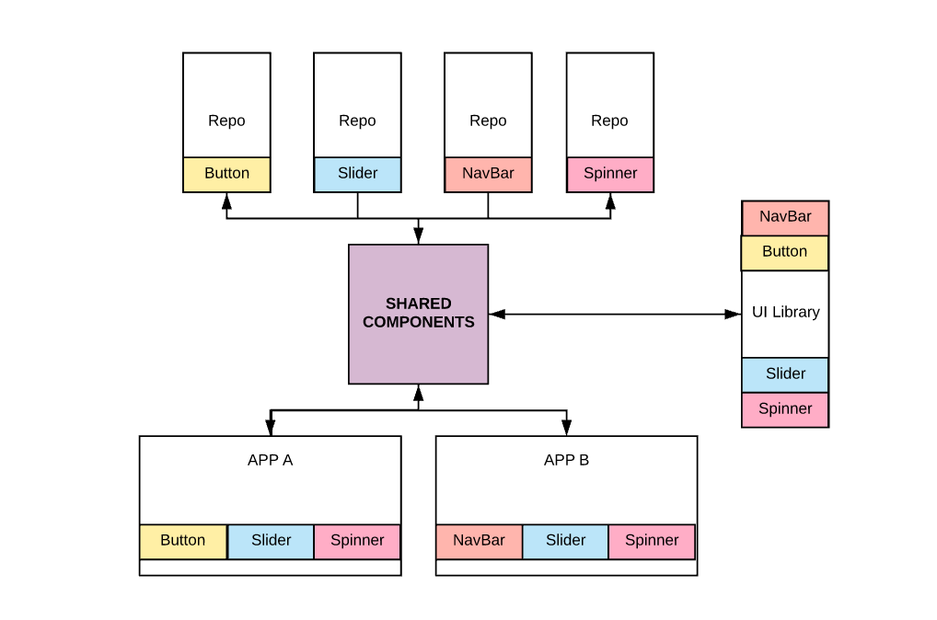
Distributed Application(1/2)
Complexity and Coupling in Shared Components :
  Kubernetes is a platform for creating, deploying, and managing “distributed applications”. These applications come in many different shapes and sizes, but ultimately, they are all comprised of one or more programs that run on individual machines. These programs accept input, manipulate data, and then return the results.
  Before we can even consider building a distributed system, we must first consider how to build the application container images that contain these programs and make up the pieces of our distributed system.
  Application programs are typically comprised of a language runtime, libraries, and your source code. In many cases, your application relies on external shared libraries such as libc and libssl. These external libraries are generally shipped as “shared components” in the OS that you have installed on a particular machine.
  This dependency on shared libraries causes problems when an application developed on a programmer’s laptop has a dependency on a shared library that isn’t available when the program is rolled out to the production OS. Even when the development and production environments share the exact same version of the OS, problems can occur when developers forget to include dependent asset files inside a package that they deploy to production.
  The traditional methods of running multiple programs on a single machine require that all of these programs share the same versions of shared libraries on the system. If the different programs are developed by different teams or organizations, these shared dependencies add needless complexity and coupling between these teams.

Slide 28

Distributed Application(2/2)
Complexity and Coupling in Shared Components :
  A program can only execute successfully if it can be reliably deployed onto the machine where it should run. Too often the state of the art for deployment involves running imperative scripts, which inevitably have twisty and byzantine failure cases. This makes the task of rolling out a new version of all or parts of a distributed system a labor-intensive and difficult task.
  When working with applications it’s often helpful to package them in a way that makes it easy to share them with others. Docker, the default container runtime engine, makes it easy to package an executable and push it to a remote registry where it can later be pulled by others. The container registries are available in all of the major public clouds, and services to build images in the cloud are also available in many of them. You can also run your own registry using open source or commercial systems. These registries make it easy for users to manage and deploy private images, while image-builder services provide easy integration with continuous delivery systems.
  Container images bundle a program and its dependencies into a single artifact under a root filesystem. The most popular container image format is the Docker image format, which has been standardized by the “Open Container Initiative” to the OCI image format.
  Kubernetes supports both Docker- and OCI-compatible images via Docker and other runtimes. Docker images also include additional metadata used by a container runtime to start a running application instance based on the contents of the container image.

Slide 29
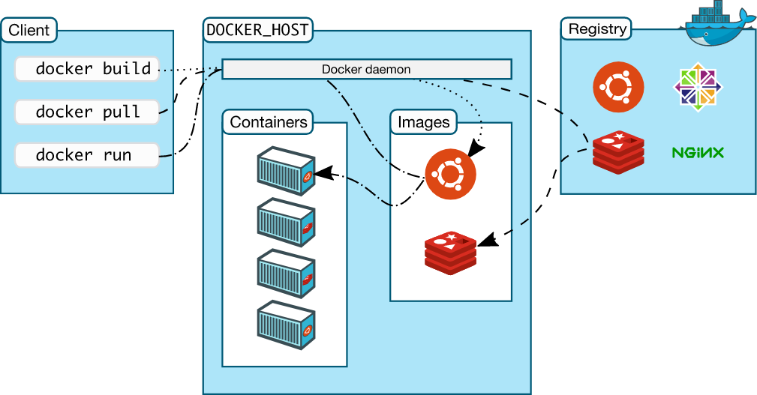
Container Images(1/5)
What is Container Image? :
  A container image is a binary package that encapsulates all of the files necessary to run a program inside of an OS container. Depending on how you first experiment with containers, you will either build a container image from your local filesystem or download a preexisting image from a container registry. In either case, once the container image is present on your computer, you can run that image to produce a running application inside an OS container.

Slide 30
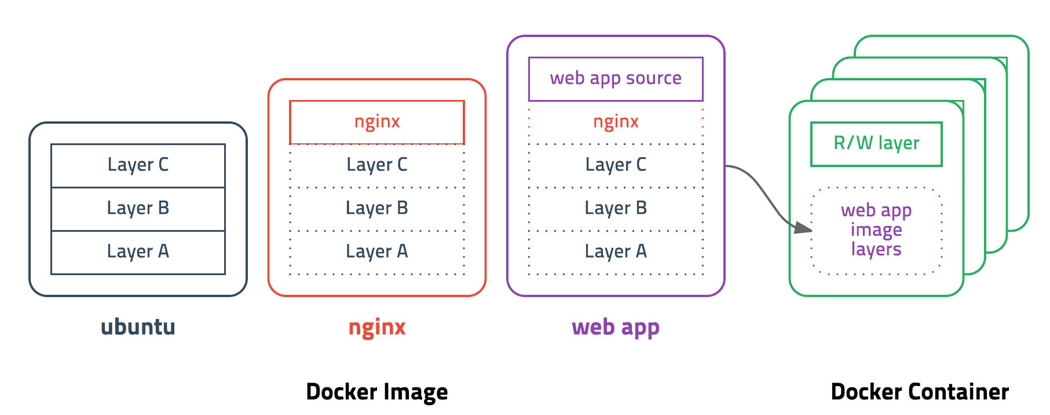
Container Images(2/5)
The Docker Image Format :
  The most popular and widespread container image format is the “Docker image format”, which was developed by the Docker open source project for packaging, distributing, and running containers using the “docker” command. Subsequently, work has begun by Docker, Inc., and others to standardize the container image format via the Open Container Initiative (OCI) project.
  While the OCI standard achieved a 1.0 release milestone in mid-2017, adoption of these standards is proceeding slowly. The Docker image format continues to be the de facto standard, and is made up of a series of filesystem layers. Each layer adds, removes, or modifies files from the preceding layer in the filesystem. This is an example of an “overlay filesystem”.
  The overlay system is used both when packaging up the image and when the image is actually being used. During runtime, there are a variety of different concrete implementations of such filesystems, including aufs, overlay, and overlay2.

Slide 31
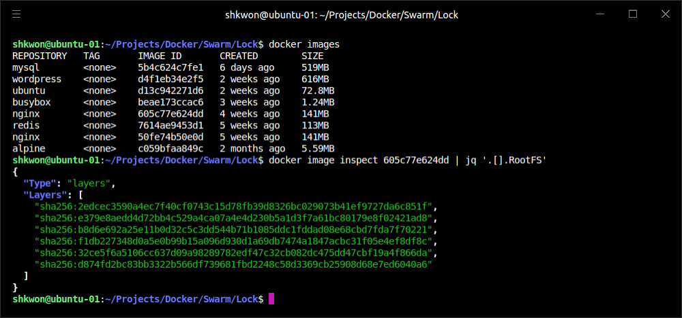
Container Images(3/5)
The Docker Image Format :
  The phrases “Docker image format” and “container images” may be a bit confusing. The image isn’t a single file but rather a specification for a manifest file that points to other files. The manifest and associated files are often treated by users as a unit. The level of indirection allows for more efficient storage and transmittal. Associated with this format is an API for uploading and downloading images to an image registry.

Slide 32
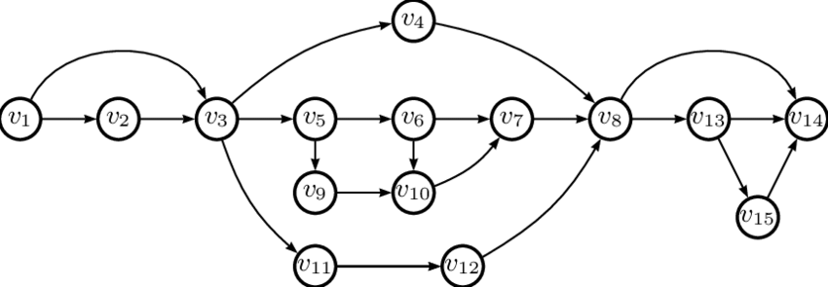
Container Images(4/5)
The Docker Image Format :
  Container images are constructed with a series of filesystem layers, where each layer inherits and modifies the layers that came before it. Note that for correctness the ordering of the layers should be bottom up, but for ease of understanding we take the opposite approach :
  At this point we have three containers: A, B, and C. B and C are forked from A and share nothing besides the base container’s files. Taking it further, we can build on top of B by adding Rails (version 4.2.6). We may also want to support a legacy application that requires an older version of Rails (e.g., version 3.2.x). We can build a container image to support that application based on B also, planning to someday migrate the app to version 4 :
  Conceptually, each container image layer builds upon a previous one. Each parent reference is a pointer. While the example here is a simple set of containers, other real-world containers can be part of a larger extensive directed acyclic graph(DAG).
.
└── container A: a base operating system only, such as Debian
└── container B: build upon #A, by adding Ruby v2.1.10
└── container C: build upon #A, by adding Golang v1.6
. (continuing from above)
└── container B: build upon #A, by adding Ruby v2.1.10
└── container D: build upon #B, by adding Rails v4.2.6
└── container E: build upon #B, by adding Rails v3.2.x

Slide 33
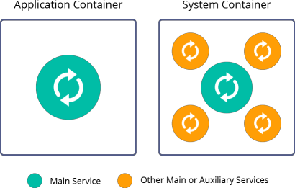
Container Images(5/5)
The Docker Image Format :
  Container images are typically combined with a container configuration file, which provides instructions on how to set up the container environment and execute an application entry point. The container configuration often includes information on how to set up networking, namespace isolation, resource constraints (cgroups), and what syscall restrictions should be placed on a running container instance. The container root filesystem and configuration file are typically bundled using the Docker image format.
  Containers fall into two main categories :
    System containers
    Application containers
  System containers seek to mimic virtual machines and often run a full boot process. They often include a set of system services typically found in a VM(Virtual Machine), such as ssh, cron, and syslog. When Docker was new, these types of containers were much more common. Over time, they have come to be seen as poor practice and application containers have gained favor.
  Application containers differ from system containers in that they commonly run a single program. While running a single program per container might seem like an unnecessary constraint, it provides the perfect level of granularity for composing scalable applications and is a design philosophy that is leveraged heavily by “Pods”.

Slide 34
Building Application Images with Docker(1/9)
Dockerfile Example :
  In general, container orchestration systems like Kubernetes are focused on building and deploying distributed systems made up of “application containers”. A “Dockerfile” can be used to automate the creation of a Docker container image.
  Building an application image for a simple Node.js program. This example would be very similar for many other dynamic languages, like Python or Ruby. The simplest of npm/Node/Express apps has two files: “package.json” and “server.js”. Put these in a directory and then run “npm install express --save” command to establish a dependency on Express and install it.
{
"name": "simple-node",
"version": "1.0.0",
"description": "A sample simple application for Kubernetes Up & Running",
"main": "server.js",
"scripts": {
"start": "node server.js"
},
"author": ""
}
package.json
var express = require('express');
var app = express();
app.get('/', function (req, res) {
res.send('Hello World!');
});
app.listen(3000, function () {
console.log('Listening on port 3000!');
console.log(' http://localhost:3000');
});
server.js

Slide 35
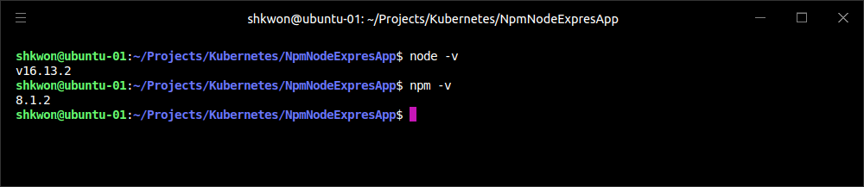
NOTE : Before You Go Further
Installation of Node.JS on Ubuntu 20.04 :
  The current(2022.01.27) stable version of Node.JS is 16.13.2. If you want to download and install the current version, use the following commands.
curl -sL https://deb.nodesource.com/setup_24.x -o nodesource_setup.sh
sudo bash nodesource_setup.sh
sudo apt install nodejs
node -v
npm -v

Slide 36
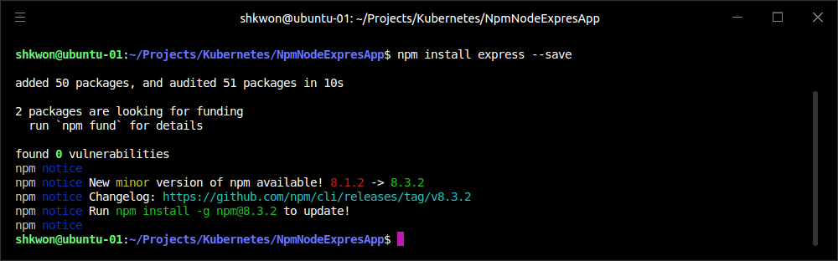
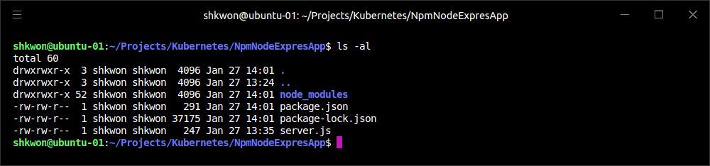
Building Application Images with Docker(2/9)
Dockerfile Example :
  After running the command, you can get the following screenshot. You will find “node_modules” directory, which has all the dependent packages.
npm install express --save

Slide 37
Building Application Images with Docker(3/9)
Dockerfile Example :
  To package this up as a Docker image we need to create two additional files : “.dockerignore” and the “Dockerfile”. The Dockerfile is a recipe for how to build the container image, while .dockerignore defines the set of files that should be ignored when copying files into the image. A full description of the syntax of the Dockerfile is available on the Docker website.
node_modules
.dockerignore
# Start from a Node.js 16.13.2 (LTS) image
FROM node:16.13.2
# Specify the directory inside the image in which all commands will run
WORKDIR /usr/src/app
# Copy package files and install dependencies
COPY package*.json ./
RUN npm install
# Copy all of the app files into the image
COPY . .
# The default command to run when starting the container
CMD [ "npm", "start" ]
Dockerfile
Every Dockerfile builds on other container images. The “FROM” line specifies that we are starting from the node:16.13.2 image on the Docker Hub. This is a preconfigured image with Node.js 16.13.2.
The “WORKDIR” line sets the work directory, in the container image, for all following commands.
The “COPY” and “RUN” lines initialize the dependencies for Node.js. First we copy the package files into the image. This will include package.json and package-lock.json. The RUN command then runs the correct command in the container to install the necessary dependencies.
In the second “COPY” line, now we copy the rest of the program files into the image. This will include everything except node_modules, as that is excluded via the .dockerignore file.
Finally, we specify the command that should be run when the container is run.

Slide 38
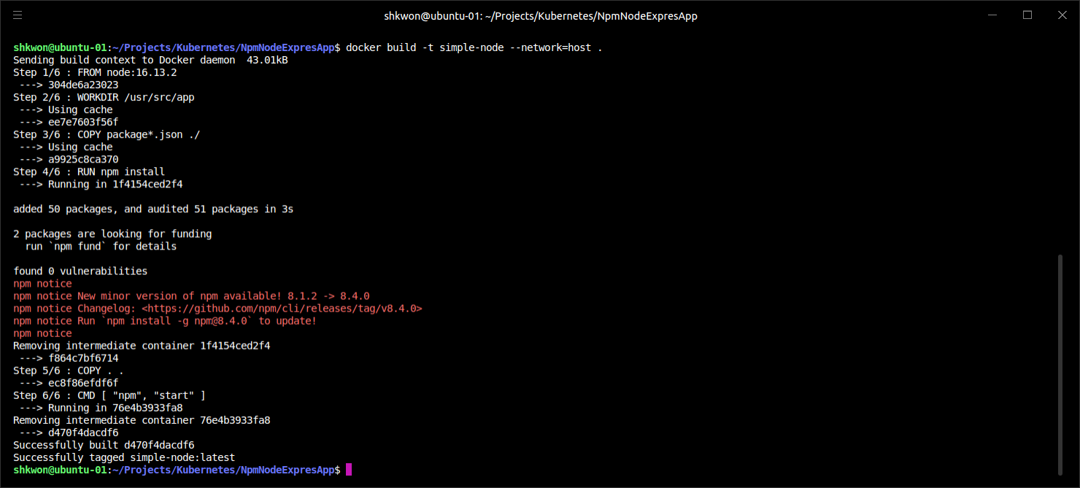
Building Application Images with Docker(4/9)
Dockerfile Example :
  Run the following command to create the “simple-node” Docker image :
docker build -t simple-node --network=host .
In VMware Workstation Pro, you need to add “--network” flag. In VirtualBox, just skip it.
NOTICE!!! You need to specify “network setting” with “--network=host” to build Docker image. It means “Set the networking mode for the RUN instructions during build”.

Slide 39
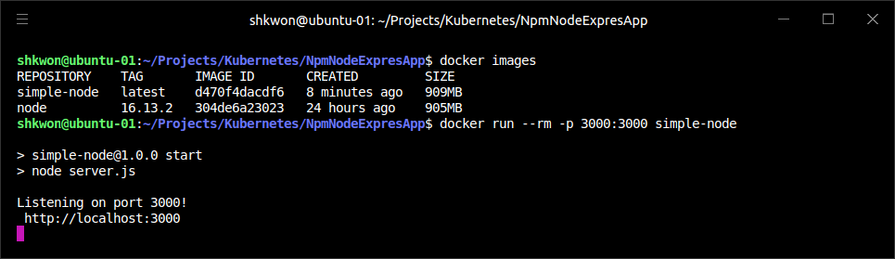
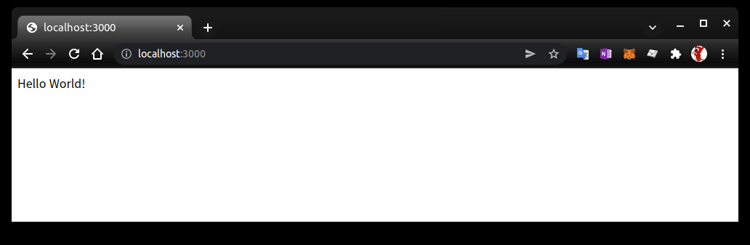
Building Application Images with Docker(5/9)
Dockerfile Example :
  When you want to run this image, you can do it with the following command. You can navigate to “http://localhost:3000” to access the program running in the container :
docker run --rm -p 3000:3000 simple-node
--rm : clear resources after exit.
-p : map host port to container port
NOTE : If you want to stop “simple-node”, “docker container rm <Container ID> -f” command.

Slide 40
NOTE : Removing NPM Notice Message in Container
Install New NPM in the Container Image :
  Use the following “Dockerfile” for removing “npm notice” message. The latest version of NPM (2022.01.28) is “8.4.0”.
  “RUN npm install –g npm@8.4.0” will install the new version of npm in the container image. When you run “npm” next, you will not see the “notice message”.
  NOTE : The “npm(Node Package Manager)” is now can be replace by “yarn”. You can install “yarn” with “sudo apt-get install yarn”.
# Start from a Node.js 16.13.2 (LTS) image
FROM node:16.13.2
# Specify the directory inside the image in which all commands will run
WORKDIR /usr/src/app
# Copy package files and install dependencies
COPY package*.json ./
RUN npm install -g npm@8.4.0
RUN npm install
# Copy all of the app files into the image
COPY . .
# The default command to run when starting the container
CMD [ "npm", "start" ]

Slide 41
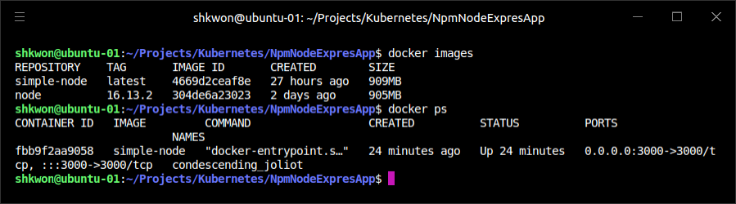
Building Application Images with Docker(6/9)
Dockerfile Example :
  At this point our “simple-node” image lives in the local Docker registry where the image was built and is only accessible to a single machine. The true power of Docker comes from the ability to share images across thousands of machines and the broader Docker community.
docker images

Slide 42
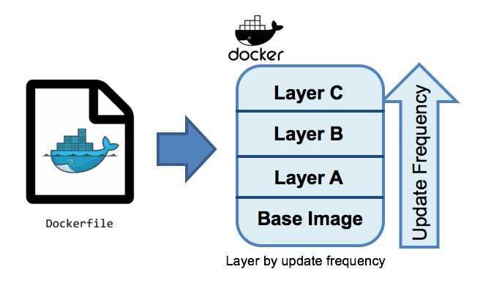
Building Application Images with Docker(7/9)
Optimizing Image Sizes :
  There are several gotchas that come when people begin to experiment with container images that lead to overly large images. The first thing to remember is that files that are removed by subsequent layers in the system are actually still present in the images; they’re just inaccessible. Consider the following situation :
  You might think that BigFile is no longer present in this image. After all, when you run the image, it is no longer accessible. But in fact it is still present in layer A, which means that whenever you push or pull the image, BigFile is still transmitted through the network, even if you can no longer access it.
  Another pitfall that people fall into revolves around image caching and building. Remember that each layer is an independent delta from the layer below it. Every time you change a layer, it changes every layer that comes after it. Changing the preceding layers means that they need to be rebuilt, repushed, and repulled to deploy your image to development.
.
── layer A: contains a large file named 'BigFile’
── layer B: removes 'BigFile’
└── layer C: builds on B by adding a static binary

Slide 43
Building Application Images with Docker(8/9)
Optimizing Image Sizes :
  To understand this more fully, consider two images :
  It seems obvious that both of these images will behave identically, and indeed the first time they are pulled they do. However, consider what happens when “server.js” changes. In one case, it is only the change that needs to be pulled or pushed, but in the other case, both “server.js” and the layer providing the “node” package need to be pulled and pushed, since the “node” layer is dependent on the “server.js” layer.
  In general, you want to order your layers from least likely to change to most likely to change in order to optimize the image size for pushing and pulling. This is why we copy the “package*.json” files and install dependencies before copying the rest of the program files. A developer is going to update and change the program files much more often than the dependencies.
.
└── layer A: contains a base OS
└── layer B: adds source code server.js
└── layer C: installs the 'node' package
VS.
.
└── layer A: contains a base OS
└── layer B: installs the 'node' package
└── layer C: adds source code server.js

Slide 44
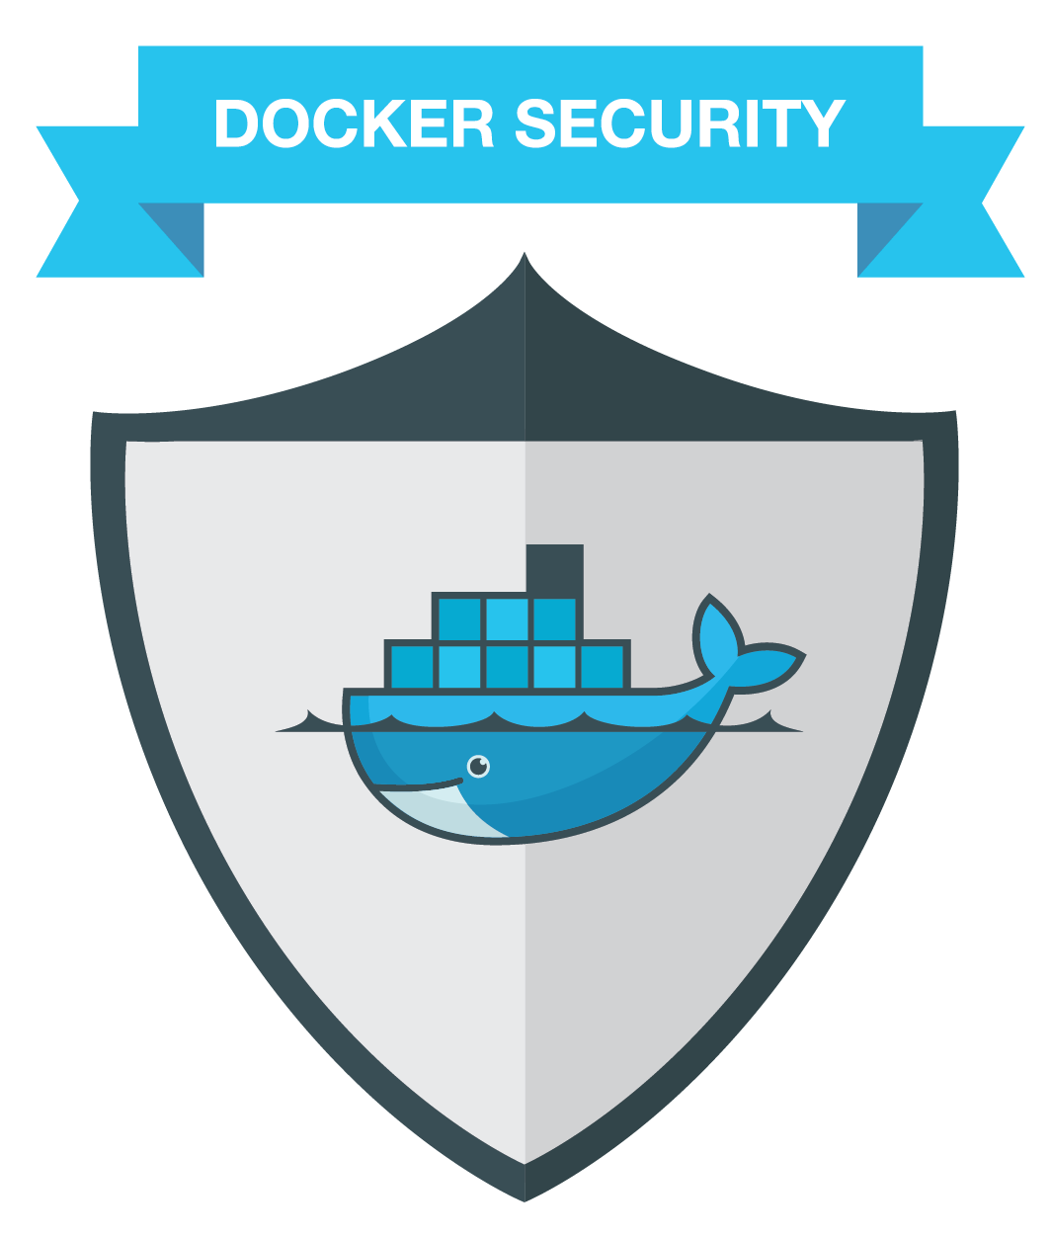
Building Application Images with Docker(9/9)
Image Security :
  When it comes to security, there are no shortcuts. When building images that will ultimately run in a production Kubernetes cluster, be sure to follow best practices for packaging and distributing applications.
  For example, don’t build containers with passwords baked in—and this includes not just in the final layer, but any layers in the image. One of the counterintuitive problems introduced by container layers is that deleting a file in one layer doesn’t delete that file from preceding layers. It still takes up space, and it can be accessed by anyone with the right tools—an enterprising attacker can simply create an image that only consists of the layers that contain the password.
  Secrets and images should never be mixed. If you do so, you will be hacked, and you will bring shame to your entire company or department.

Slide 45
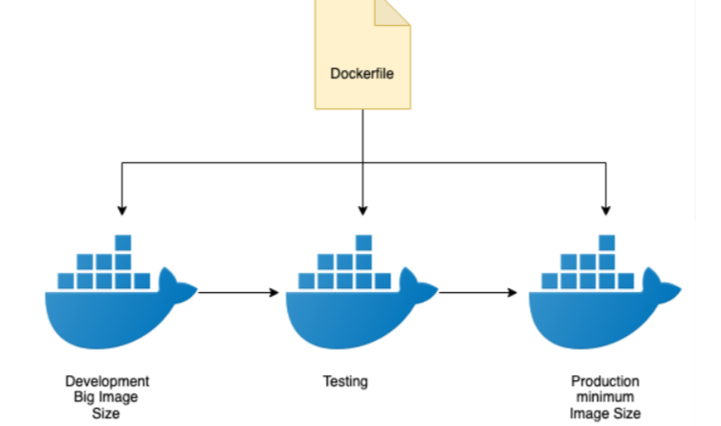
Multistage Image Builds(1/4)
Building Light Image :
  One of the most common ways to accidentally build large images is to do the actual program compilation as part of the construction of the application container image. Compiling code as part of the image build feels natural, and it is the easiest way to build a container image from your program. The trouble with doing this is that it leaves all of the unnecessary development tools, which are usually quite large, lying around inside of your image and slowing down your deployments.
  To resolve this problem, Docker introduced multistage builds. With multistage builds, rather than producing a single image, a Docker file can actually produce multiple images. Each image is considered a stage. Artifacts can be copied from preceding stages to the current stage.
  The example application, kuard, is a somewhat complicated application that involves a React.js frontend (with its own build process) that then gets embedded into a Go program. The Go program runs a backend API server that the React.js frontend interacts with.

Slide 46
Multistage Image Builds(2/4)
Building Light Image :
  A simple Dockerfile might look like this :
  This Dockerfile produces a container image containing a static executable, but it also contains all of the Go development tools and the tools to build the React.js frontend and the source code for the application, neither of which are needed by the final application. The image, across all layers, adds up to over 500 MB.
FROM golang:1.12-alpine
# Install node and npm
RUN apk update && apk upgrade && apk add --no-cache git nodejs bash npm
# Get dependencies or go part of the build
RUN go get -u github.com/jteeuwen/go-bindata/...
RUN go get github.com/tools/godep
WORKDIR /go/src/github.com/kubernetes-up-and-running/kuard
# copy all sources in
COPY . .
# Set of variables the build script expects
ENV VERBOSE=0
ENV PKG=github.com/kubernetes-up-and-running/kuard
ENV ARCH=amd64
ENV VERSION=test
# When running on Windows 10, you need to clean up the ^Ms in the script
RUN dos2unix build/build.sh
# Do the build. The script is part of incoming sources.
RUN build/build.sh
CMD [ "/go/bin/kuard" ]

Slide 47
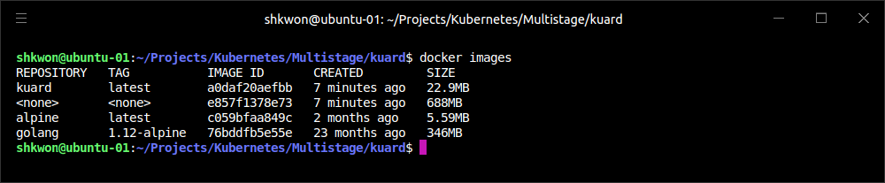
NOTE : Build “kuard” Image
Docker Image Build :
  Use the following command to build the previous example image.
mkdir kuard
git clone https://github.com/kubernetes-up-and-running/kuard.git
cd kuard
docker build -t kuard .

Slide 48
Multistage Image Builds(3/4)
Building Light Image :
  To see how we would do this with multistage builds, examine this multistage Dockerfile :
  Building a container image using multistage builds can reduce your final container image size by hundreds of megabytes and thus dramatically speed up your deployment times, since generally, deployment latency is gated on network performance. The final image produced from this Dockerfile is somewhere around 20 MB(“kuard”).
# STAGE 1: Build
FROM golang:1.12-alpine AS build
# Install Node and NPM.
RUN apk update && apk upgrade && apk add --no-cache git nodejs bash npm
# Get dependencies for Go part of build
RUN go get -u github.com/jteeuwen/go-bindata/...
WORKDIR /go/src/github.com/kubernetes-up-and-running/kuard
# Copy all sources in
COPY . .
# This is a set of variables that the build script expects
ENV VERBOSE=0
ENV PKG=github.com/kubernetes-up-and-running/kuard
ENV ARCH=amd64
ENV VERSION=test
# When running on Windows 10, you need to clean up the ^Ms in the script
RUN dos2unix build/build.sh
# Do the build. Script is part of incoming sources.
RUN build/build.sh
# STAGE 2: Runtime
FROM alpine
USER nobody:nobody
COPY --from=build /go/bin/kuard /kuard
CMD [ "/kuard" ]
This Dockerfile produces two images. The first is the build image, which contains the Go compiler, React.js toolchain, and source code for the program. The second is the deployment image, which simply contains the compiled binary.

Slide 49
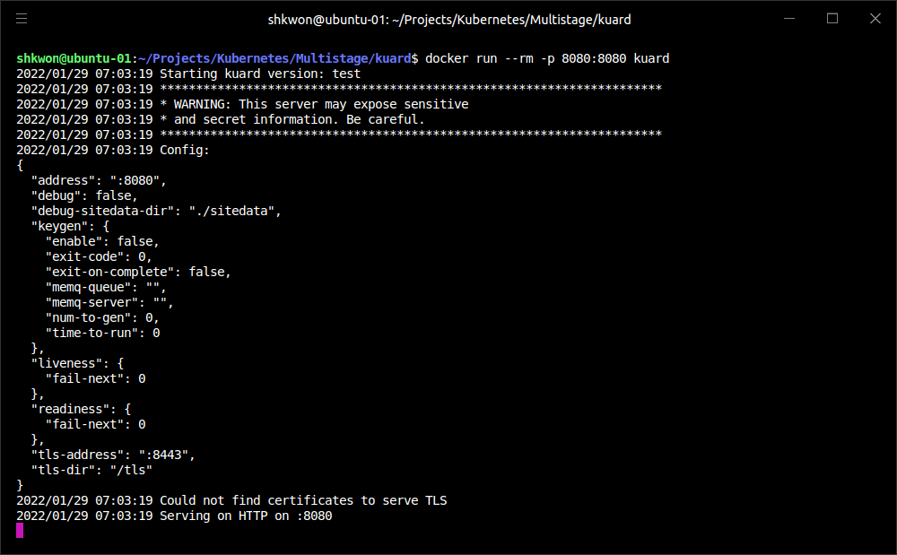
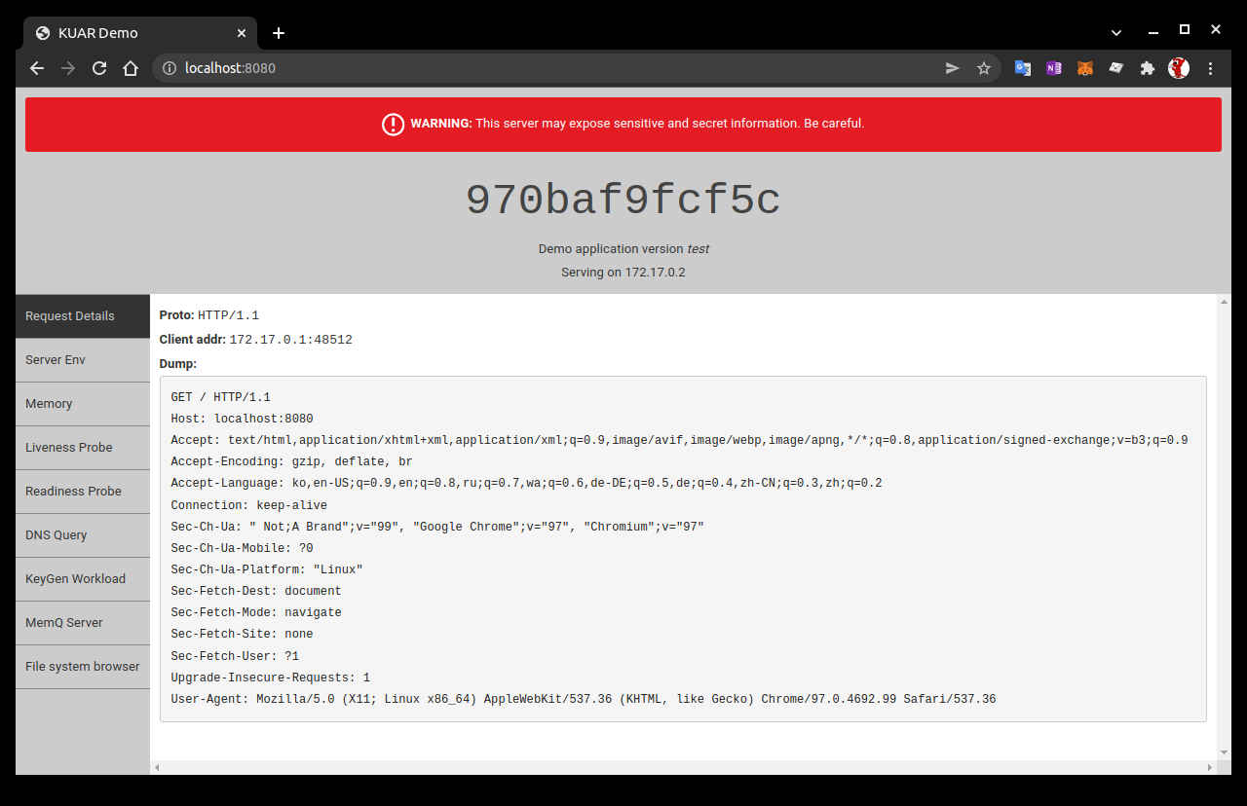
Multistage Image Builds(4/4)
Building Light Image :
  You can build and run this image with the following commands :
docker build -t kuard .
docker run --rm -p 8080:8080 kuard

Slide 50
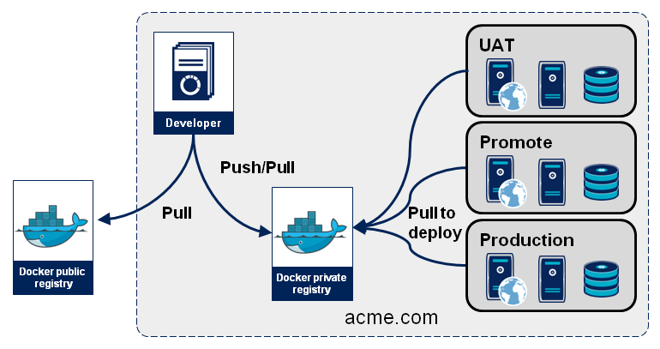
Storing Images in a Remote Registry(1/2)
Private and Public Registries :
  Kubernetes relies on the fact that images described in a Pod manifest are available across every machine in the cluster. One option for getting this image to all machines in the cluster would be to export the “kuard” image and import it on each of them. The process of manually importing and exporting Docker images has human error written all over it.
  The standard within the Docker community is to store Docker images in a remote registry. There are tons of options when it comes to Docker registries, and what you choose will be largely based on your needs in terms of security and collaboration features.
  Generally speaking, the first choice you need to make regarding a registry is whether to use a private or a public registry. Public registries allow anyone to download images stored in the registry, while private registries require authentication to download images. In choosing public versus private, it’s helpful to consider your use case.
  Public registries are great for sharing images with the world, because they allow for easy, unauthenticated use of the container images. You can easily distribute your software as a container image and have confidence that users everywhere will have the exact same experience.

Slide 51
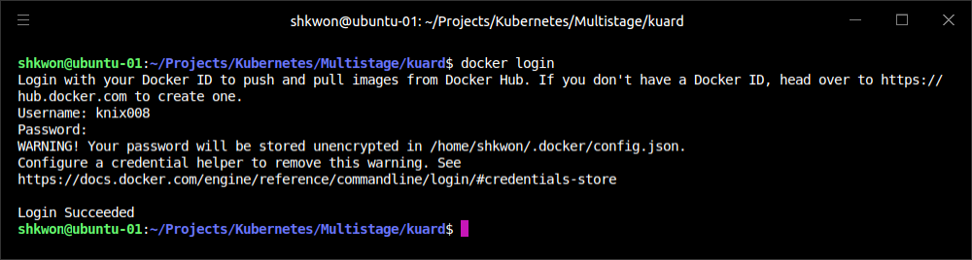
Storing Images in a Remote Registry(2/2)
Private and Public Registries :
  In contrast, a private registry is best for storing applications that are private to your service and that you don’t want the world to use.
  Regardless, to push an image, you need to authenticate to the registry. You can generally do this with the “docker login” command, though there are some differences for certain registries. We can push the image into the Google Cloud Platform registry, called the “Google Container Registry (GCR)”; other clouds, including “Azure” and “Amazon Web Services (AWS)”, also have hosted container registries. For new users hosting publicly readable images, the Docker Hub is a great place to start.
  Once you are logged in, you can tag the “kuard” image by prepending the target Docker registry. You can also append another identifier that is usually used for the version or variant of that image, separated by a colon (:). Then Then you can push the “kuard” image :
docker login
docker tag <IMAGE ID> <USER NAME>/<IMAGE NAME>:<TAG>
docker push <USER NAME>/<IMAGE NAME>:<TAG>

Slide 52
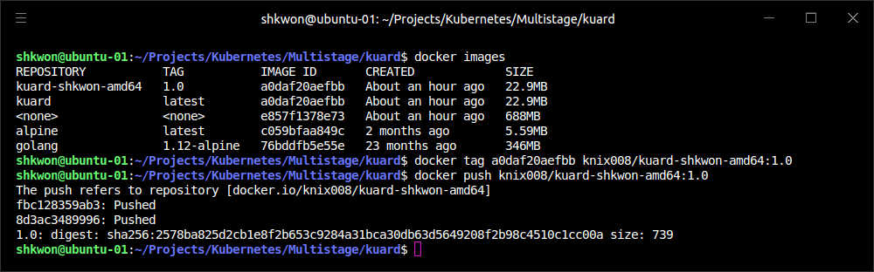
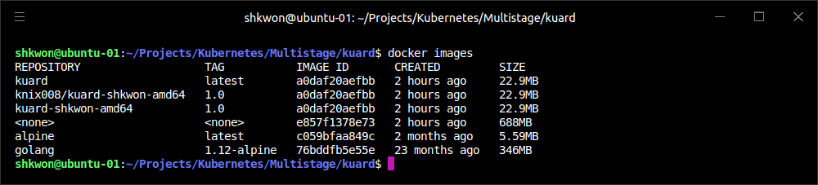
NOTE : Docker Image Upload
Using Docker Hub :
  You can “push” your docker image into the Docker Hub using the following commands. In this example, I used my login ID, “knix008”, image name, “kuard-shkwon-amd64”, and tag, “1.0”.
docker images
docker tag a0daf20aefbb knix008/kuard-shkwon-amd64:1.0
docker push knix008/kuard-shkwon-amd64:1.0

Slide 53
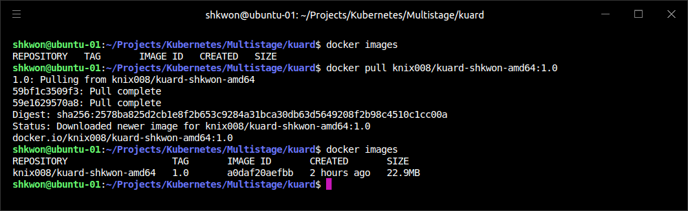
NOTE : Docker Image Download
Using Docker Hub :
  Now you can download, pull, the Docker image you just pushed from the Docker hub using the following command. Before you do pull, make sure to delete all images on your local machine with “docker rmi -f $(docker images -q)” command.
docker rmi -f $(docker images -q)
docker images
docker pull knix008/kuard-shkwon-amd64:1.0

Slide 54
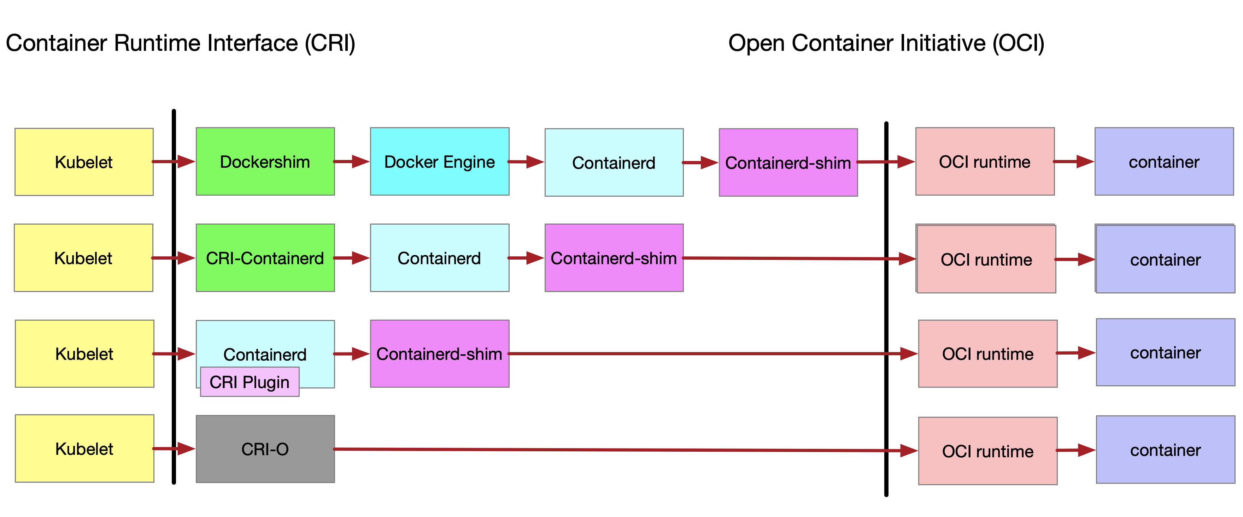
The Docker Container Runtime(1/5)
Container Runtime Interface(CRI) :
  Kubernetes provides an API for describing an application deployment, but relies on a container runtime to set up an application container using the container-specific APIs native to the target OS. On a Linux system that means configuring cgroups and namespaces.
  The interface to this container runtime is defined by the Container Runtime Interface (CRI) standard. The CRI API is implemented by a number of different programs, including the “containerd-cri” built by Docker and the “cri-o” implementation contributed by Red Hat.

Slide 55
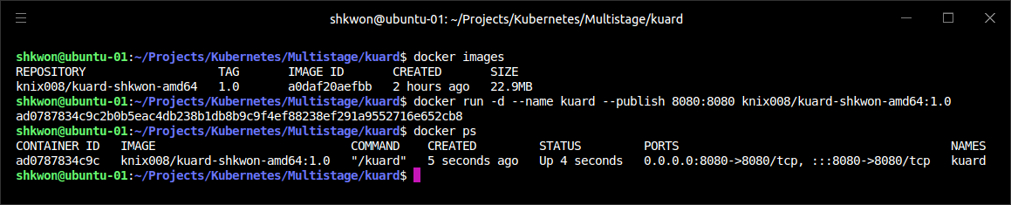
The Docker Container Runtime(2/5)
Running Containers with Docker :
  Though generally in Kubernetes containers are launched by a daemon on each node called the kubelet, it’s easier to get started with containers using the Docker command-line tool. The Docker CLI tool can be used to deploy containers. To deploy a container from the gcr.io/kuar-demo/kuard-amd64:blue image, run the following command :
  This command starts the “kuard” container and maps ports 8080 on your local machine to 8080 in the container. The “--publish” option can be shortened to “-p”. This forwarding is necessary because each container gets its own IP address, so listening on localhost inside the container doesn’t cause you to listen on your machine. Without the port forwarding, connections will be inaccessible to your machine. The “-d” option specifies that this should run in the background (daemon or detached), while “--name kuard” gives the container a friendly name.
docker run -d --name kuard --publish 8080:8080 knix008/kuard-shkwon-amd64:1.0

Slide 56
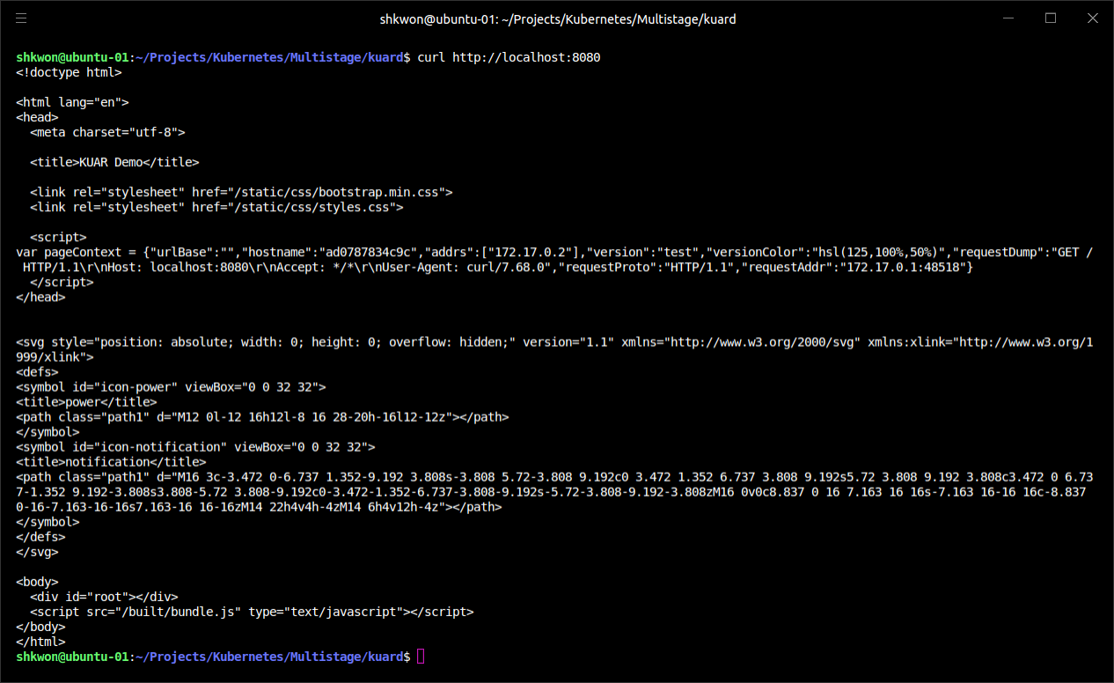
The Docker Container Runtime(3/5)
Exploring the “kuard” Application :
  “kuard” exposes a simple web interface, which you can load by pointing your browser at “http://localhost:8080” or via the command line :
curl http://localhost:8080

Slide 57
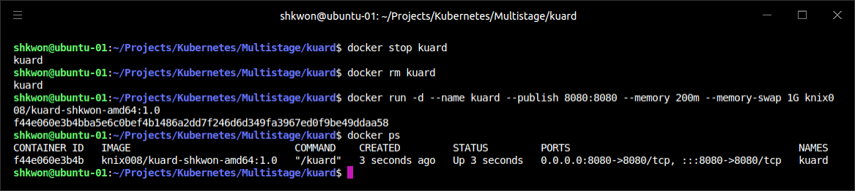
The Docker Container Runtime(4/5)
Limiting Memory Resource :
  Docker provides the ability to limit the amount of resources used by applications by exposing the underlying cgroup technology provided by the “Linux kernel”. These capabilities are likewise used by Kubernetes to limit the resources used by each Pod.
  One of the key benefits to running applications within a container is the ability to restrict resource utilization. This allows multiple applications to coexist on the same hardware and ensures fair usage.
  To limit “kuard” to 200 MB of memory and 1 GB of swap space, use the “--memory” and “--memory-swap” flags with the “docker run” command.
docker stop kuard
docker rm kuard
docker run -d --name kuard --publish 8080:8080 --memory 200m --memory-swap 1G knix008/kuard-shkwon-amd64:1.0

Slide 58
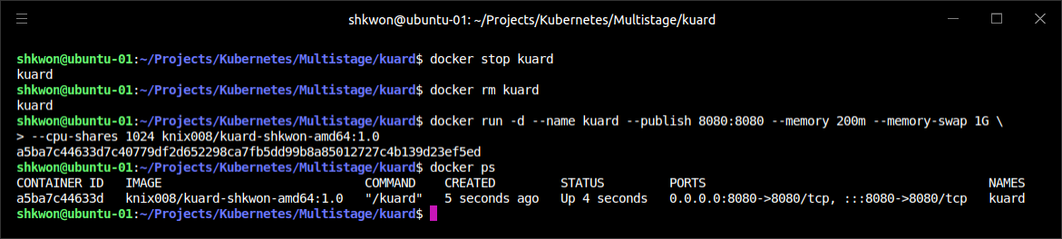
The Docker Container Runtime(5/5)
Limiting CPU Resources :
  Another critical resource on a machine is the CPU. Restrict CPU utilization using the “--cpu-shares” flag with the “docker run” command :
docker stop kuard
docker rm kuard
docker run -d --name kuard --publish 8080:8080 --memory 200m --memory-swap 1G \
--cpu-shares 1024 knix008/kuard-shkwon-amd64:1.0

Slide 59
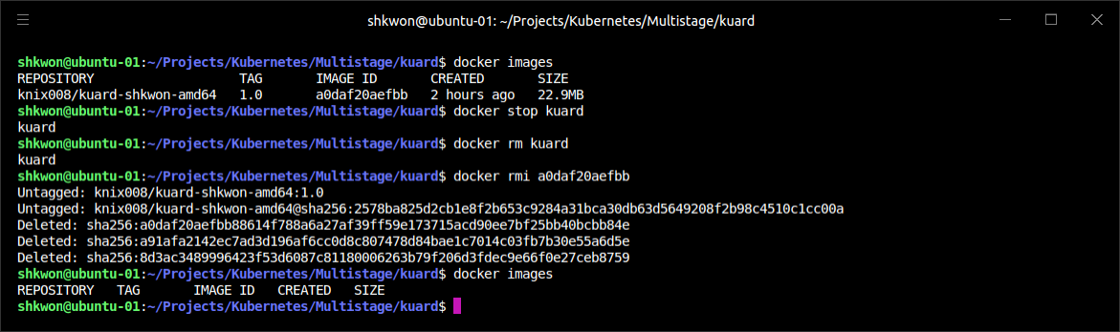
Cleanup(1/3)
Remove Image :
  Once you are done building an image, you can delete it with the “docker rmi”(Remove Image) command :
  Images can either be deleted via their tag name (e.g., “knix008/kuard-shkwon-0amd64:1.0”) or via their image ID. As with all ID values in the docker tool, the image ID can be shortened as long as it remains unique. Generally only three or four characters of the ID are necessary.
docker rmi <tag-name>
or:
docker rmi <image-id>

Slide 60
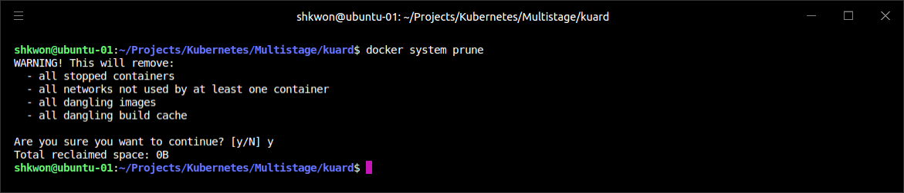
Cleanup(2/3)
Remove Image :
  It’s important to note that unless you explicitly delete an image it will live on your system forever, even if you build a new image with an identical name. Building this new image simply moves the tag to the new image; it doesn’t delete or replace the old image.
  Consequently, as you iterate while you are creating a new image, you will often create many, many different images that end up taking up unnecessary space on your computer.
  NOTE : To remove all images, you can use “docker rmi -f $(docker images -q)” command.
  NOTE : To clean up your local machine, you can use “docker system prune” command. This command will delete, images, volumes, networks, and other resources used by Docker.
docker system prune

Slide 61
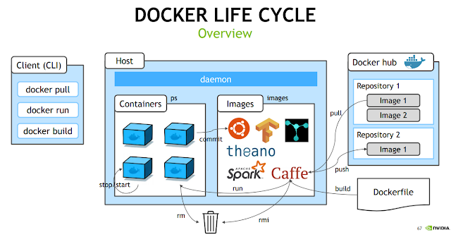
Cleanup(3/3)
Remove Image :
  To see the images currently on your machine, you can use the “docker images” command. You can then delete tags you are no longer using.
  Docker provides a tool called “docker system prune” for doing general cleanup. This will remove all stopped containers, all untagged images, and all unused image layers cached as part of the build process. Use it carefully.
  A slightly more sophisticated approach is to set up a cron job to run an image garbage collector. For example, the “docker-gc tool” is a commonly used image garbage collector that can easily run as a recurring “cron” job, once per day or once per hour, depending on how many images you are creating.

Slide 62


NOTE : Docker Hub Repository
Pushing Image :
  After pushing your Docker image, you can check your repository in Docker Hub. Sign in Docker Hub and find your pushed image.

Slide 63
Deploying a Kubernetes Cluster

Slide 64

Kubernetes Cluster
Using Cluster :
  Now that you have successfully built an application container, the next step is to learn how to transform it into a complete, reliable, scalable distributed system. To do that, you need a working Kubernetes cluster. At this point, there are cloud-based Kubernetes services in most public clouds that make it easy to create a cluster with a few command-line instructions. We highly recommend this approach if you are just getting started with Kubernetes. Even if you are ultimately planning on running Kubernetes on bare metal, it’s a good way to quickly get started with Kubernetes, learn about Kubernetes itself, and then learn how to install it on physical machines. Furthermore, managing a Kubernetes cluster is a complicated task in itself, and for most people it makes sense to defer this management to the cloud—especially when in most clouds the management service is free.
  Of course, using a cloud-based solution requires paying for those cloud-based resources as well as having an active network connection to the cloud. For these reasons, local development can be more attractive, and in that case the minikube tool provides an easy-to-use way to get a local Kubernetes cluster up running in a VM on your local laptop or desktop. Though this is a nice option, minikube only creates a single-node cluster, which doesn’t quite demonstrate all of the aspects of a complete Kubernetes cluster. For that reason, we recommend people start with a cloud-based solution, unless it really doesn’t work for their situation. A more recent alternative is to run a Docker-in-Docker cluster, which can spin up a multi-node cluster on a single machine.

Slide 65

Installing Kubernetes on a Public Cloud Provider(1/4)
Google Kubernetes Engine :
  The Google Cloud Platform offers a hosted Kubernetes-as-a-Service called Google Kubernetes Engine (GKE). To get started with GKE, you need a Google Cloud Platform account with billing enabled and the gcloud tool installed.
  Once you have gcloud installed, first set a default zone :
  Then you can create a cluster :
  This will take a few minutes. When the cluster is ready you can get credentials for the cluster using :
  If you run into trouble, you can find the complete instructions for creating a GKE cluster in the Google Cloud Platform documentation.
gcloud config set compute/zone us-west1-a
gcloud container clusters create kuar-cluster
gcloud auth application-default login

Slide 66

Installing Kubernetes on a Public Cloud Provider(2/4)
Installing Kubernetes with Azure Kubernetes Service :
  Microsoft Azure offers a hosted Kubernetes-as-a-Service as part of the Azure Container Service. The easiest way to get started with Azure Container Service is to use the built-in Azure Cloud Shell in the Azure portal. You can activate the shell by clicking the shell icon in the upper-right toolbar :
  The shell has the az tool automatically installed and configured to work with your Azure environment. Alternatively, you can install the az command-line interface (CLI) on your local machine.

Slide 67
Installing Kubernetes on a Public Cloud Provider(3/4)
Installing Kubernetes with Azure Kubernetes Service :
  When you have the shell up and working, you can run :
  Once the resource group is created, you can create a cluster using :
  This will take a few minutes. Once the cluster is created, you can get credentials for the cluster with :
  If you don’t already have the kubectl tool installed, you can install it using :
  You can find complete instructions for installing Kubernetes on Azure in the Azure documentation.
  For more information about azure-cli commands, please refer to https://docs.microsoft.com/ko-kr/cli/azure/group?view=azure-cli-latest.
az group create --name=shkwon --location=westus
az aks create --resource-group=shkwon --name=shkwon-cluster
az aks get-credentials --resource-group=shkwon --name=shkwon-cluster
az aks install-cli

Slide 68

Installing Kubernetes on a Public Cloud Provider(4/4)
Installing Kubernetes on Amazon Web Services :
  Amazon offers a managed Kubernetes service called Elastic Kubernetes Service (EKS). The easiest way to create an EKS cluster is via the open source eksctl command-line tool.
  Once you have eksctl installed and in your path, you can run the following command to create a cluster :
  For more details on installation options (such as node size and more), view the help using this command:
  The cluster installation includes the right configuration for the kubectl command-line tool. If you don’t already have kubectl installed, you can follow the instructions in the documentation(The Kubernetes Official Site).
eksctl create cluster --name shkwon-cluster ...
eksctl create cluster --help

Slide 69

Installing Kubernetes Locally(1/4)
The “minikube” :
  If you need a local development experience, or you don’t want to pay for cloud resources, you can install a simple single-node cluster using minikube. Alternatively, if you have already installed Docker Desktop, it comes bundled with a single-machine installation of Kubernetes.
  While minikube (or Docker Desktop for Windows and MacOS) is a good simulation of a Kubernetes cluster, it’s really intended for local development, learning, and experimentation. Because it only runs in a VM on a single node, it doesn’t provide the reliability of a distributed Kubernetes cluster. In addition, certain features require integration with a cloud provider. These features are either not available or work in a limited way with minikube.
NOTE - You need to have a hypervisor installed on your machine to use minikube. For Linux and macOS, this is generally virtualbox. On Windows, the Hyper-V hypervisor is the default option. Make sure you install the hypervisor before using minikube.

Slide 70

Installing Kubernetes Locally(2/4)
Minikube :
  You can find the minikube tool on GitHub. There are binaries for Linux, macOS, and Windows that you can download. Once you have the minikube tool installed, you can create a local cluster using :
  This will create a local VM, provision Kubernetes, and create a local kubectl configuration that points to that cluster.
  When you are done with your cluster, you can stop the VM with :
  If you want to remove the cluster, you can run :
minikube start
minikube stop
minikube delete

Slide 71



NOTE : Installing Minikube on Linux Ubuntu 20.04(1/6)
Minimum Requirements :
  2 Core CPU, 4GB RAM, Enabled Local Host Virtual Machine, Server Root Password.
  We will use Ubuntu 20.04 for Minikube install.
Installation :
  Step 01. Before we start to install minikube, update all packages with “apt-get update -y” command and install “curl, wget, apt-transport-https virtualbox virtualbox-ext-pack” with the following command.
sudo apt-get update -y
sudo apt-get install curl wget apt-transport-https virtualbox virtualbox-ext-pack -y

Slide 72

NOTE : Installing Minikube on Linux Ubuntu 20.04(2/6)
Installation :
  Step 02. Install Docker. We assume that you already installed Docker. Just find out the Docker version with “docker --version” command.
  NOTE : You need to enable docker daemon and containerd service with “sudo systemctl enable docker” and “sudo systemctl enable containerd” commands. Then start the Docker service with “sudo systemctl start docker” and “sudo systemctl start containerd” commands. To see the daemon status, use “sudo service docker status” and “sudo service containerd status” commands.
docker --version

Slide 73

NOTE : Installing Minikube on Linux Ubuntu 20.04(3/6)
Installation :
  Step 03. To install minikube, you need to download the “minikube” package. Use the following command.
wget https://storage.googleapis.com/minikube/releases/latest/minikube-linux-amd64

Slide 74

NOTE : Installing Minikube on Linux Ubuntu 20.04(4/6)
Installation :
  Step 04. Copy the downloaded minikube into “/usr/local/bin” directory and change the persmission. Use the following command.
sudo cp minikube-linux-amd64 /usr/local/bin/minikube
sudo chmod 755 /usr/local/bin/minikube
minikube version

Slide 75

NOTE : Installing Minikube on Linux Ubuntu 20.04(5/6)
Installation :
  Step 05. Install kubectl. To manage applications, you need to install kubectl and other tools. Add the GPG key first and add kubenetes repository using the following commands.
curl -s https://packages.cloud.google.com/apt/doc/apt-key.gpg | sudo apt-key add -
echo "deb http://apt.kubernetes.io/ kubernetes-xenial main" | sudo tee /etc/apt/sources.list.d/kubernetes.list

Slide 76

NOTE : Installing Minikube on Linux Ubuntu 20.04(6/6)
Installation :
  Step 06. Now it’s time to update your repository cache and install kubectl. Run the following commands.
sudo apt-get update -y
sudo apt-get install kubelet kubeadm kubectl -y

Slide 77

Installing Kubernetes Locally(3/4)
Minikube :
  Once you have the minikube tool installed, you can create a local cluster using the following command. This will create a local VM, provision Kubernetes, and create a local kubectl configuration that points to that cluster.
minikube start

Slide 78


Installing Kubernetes Locally(4/4)
Minikube :
  When you are done with your cluster, you can stop the VM with the following command :
  If you want to remove the cluster, you can run the following command :
minikube stop
minikube delete

Slide 79


NOTE : Disable Swapping in Linux Ubuntu 20.04
Swapping :
  Swapping in Linux will make a system slow when you run “minikube”. If you want to disable swapping in Linux Ubuntu 20.04, follow the next steps.
  Step 01. Check the swapping and disable it.
  Step 02. Comment out the “/swapfile xxx” line in the “/etc/fstab” file. This will make a change permanent for rebooting.
$ sudo swapon -show
$ sudo swapoff -a

Slide 80

Running Kubernetes in Docker
KIND(Kubernetes IN Docker) :
  A different approach to running a Kubernetes cluster has been developed more recently, which uses Docker containers to simulate multiple Kubernetes nodes instead of running everything in a virtual machine. The kind project provides a great experience for launching and managing test clusters in Docker. (“kind“ stands for Kubernetes IN Docker.) kind is still a work in progress (pre 1.0), but is widely used by those building Kubernetes for fast and easy testing.
  Installation instructions for your platform can be found at the kind site. Once you get it installed, creating a cluster is as easy as :
kind create cluster --wait 5m \
export KUBECONFIG="$(kind get kubeconfig-path)"
kubectl cluster-info
kind delete cluster

Slide 81

The Kubernetes Client(1/10)
Kubectl :
  The official Kubernetes client is kubectl : a command-line tool for interacting with the Kubernetes API. kubectl can be used to manage most Kubernetes objects, such as Pods, ReplicaSets, and Services. kubectl can also be used to explore and verify the overall health of the cluster.

Slide 82

The Kubernetes Client(2/10)
Checking Cluster Status :
  The first thing you can do is check the version of the cluster that you are running with the following command :
kubectl version

Slide 83

The Kubernetes Client(3/10)
Checking Cluster Status :
  The “kubectl version” command will display two different versions : the version of the local kubectl tool, as well as the version of the Kubernetes API server.
  NOTE : Don’t worry if these versions are different. The Kubernetes tools are backward- and forward-compatible with different versions of the Kubernetes API, so long as you stay within two minor versions for both the tools and the cluster and don’t try to use newer features on an older cluster. Kubernetes follows the semantic versioning specification, where the minor version is the middle number (e.g., the 5 in 1.5.2).
  If you can see the correct result of the “kubectl version” command, you have established that you can communicate with your Kubernetes cluster.
  First, you can get a simple diagnostic for the cluster. This is a good way to verify that your cluster is generally healthy :
kubectl get componentstatuses

Slide 84

The Kubernetes Client(4/10)
Checking Cluster Status :
  You can see the components that make up the Kubernetes cluster. The controller-manager is responsible for running various controllers that regulate behavior in the cluster; for example, ensuring that all of the replicas of a service are available and healthy. The scheduler is responsible for placing different Pods onto different nodes in the cluster. Finally, the etcd server is the storage for the cluster where all of the API objects are stored.

Slide 85

The Kubernetes Client(5/10)
Listing Kubernetes Worker Nodes :
  You can list out all of the nodes in your cluster with “kubectl get nodes” command.
  You can see that there is one node cluster that’s been up for 18 hours. In Kubernetes, nodes are separated into master nodes that contain containers like the API server, scheduler, etc., which manage the cluster, and worker nodes where your containers will run.
  Kubernetes won’t generally schedule work onto master nodes to ensure that user workloads don’t harm the overall operation of the cluster.
kubectl get nodes

Slide 86

The Kubernetes Client(6/10)
Listing Kubernetes Worker Nodes :
  You can use the “kubectl describe nodes” command to get more information about a specific node :
kubectl describe nodes minikube

Slide 87

The Kubernetes Client(7/10)
Listing Kubernetes Worker Nodes :
  You can see that the node is running the Linux OS and is running on an AMD64 processor. You can also see information about the operation of node itself :
  These statuses(Conditions) show that the node has sufficient disk and memory space and is reporting that it is healthy to the Kubernetes master.

Slide 88


The Kubernetes Client(8/10)
Listing Kubernetes Worker Nodes :
  There is information about the capacity of the machine :
  Then there is information about the software on the node, including the version of Docker that is running, the versions of Kubernetes and the Linux kernel, and more :

Slide 89

The Kubernetes Client(9/10)
Listing Kubernetes Worker Nodes :
  Finally, there is information about the Pods that are currently running on this node :

Slide 90

The Kubernetes Client(10/10)
Listing Kubernetes Worker Nodes :
  From the previous output(about Pods) you can see the Pods on the node, the CPU and memory that each Pod is requesting from the node, as well as the total resources requested. It’s worth noting here that Kubernetes tracks both the requests and upper limits for resources for each Pod that runs on a machine. The difference between requests and limits is that resources requested by a Pod are guaranteed to be present on the node, while a Pod’s limit is the maximum amount of a given resource that a Pod can consume. A Pod’s limit can be higher than its request, in which case the extra resources are supplied on a best-effort basis. They are not guaranteed to be present on the node.

Slide 91

Cluster Components(1/5)
Kubernetes Components :
  One of the interesting aspects of Kubernetes is that many of the components that make up the Kubernetes cluster are actually deployed using Kubernetes itself. All of these components run in the kube-system namespace.
Kubernetes Proxy :
  The Kubernetes proxy is responsible for routing network traffic to load-balanced services in the Kubernetes cluster. To do its job, the proxy must be present on every node in the cluster. Kubernetes has an API object named DaemonSet that is used in many clusters to accomplish this. If your cluster runs the Kubernetes proxy with a DaemonSet, you can see the proxies by running :
  Depending on how your cluster is set up, the DaemonSet for the kube-proxy may be named something else, or its possible that it won’t use a DaemonSet at all. Regardless, the kube-proxy container should be running on all nodes in a cluster.
kubectl get daemonSets --namespace=kube-system kube-proxy

Slide 92

Cluster Components(2/5)
Kubernetes DNS(Domain Name Service) :
  Kubernetes also runs a DNS server, which provides naming and discovery for the services that are defined in the cluster. This DNS server also runs as a replicated service on the cluster. Depending on the size of your cluster, you may see one or more DNS servers running in your cluster. The DNS service is run as a Kubernetes deployment, which manages these replicas :
kubectl get deployments --namespace=kube-system

Slide 93

Cluster Components(3/5)
Kubernetes DNS(Domain Name Service) :
  There is also a Kubernetes service that performs load balancing for the DNS server :
  This shows that the DNS service for the cluster has the address “10.96.0.10”. If you log in to a container in the cluster, you’ll see that this has been populated into the “/etc/resolv.conf” file for the container.
kubectl get services --namespace=kube-system

Slide 94


Cluster Components(4/5)
Kubernetes UI :
  The final Kubernetes component is a GUI. The UI is run as a single replica, but it is still managed by a Kubernetes deployment for reliability and upgrades. You can see this UI server using :
  NOTE : You can get the name space with “kubectl describe node <NODE NAME>” command.
kubectl get deployments --namespace=kubernetes-dashboard

Slide 95

NOTE : Kubernetes Dashboard
Running the Service :
  To run the “kubernetes dashboard”, you need to run the following commands.
kubectl apply -f https://raw.githubusercontent.com/kubernetes/dashboard/v2.4.0/aio/deploy/recommended.yaml
kubectl proxy

Slide 96

Cluster Components(5/5)
Kubernetes UI :
  The dashboard also has a service that performs load balancing for the dashboard :
  You can use “kubectl proxy” command to access the UI. This starts up a server running on localhost:8001. If you visit http://localhost:8001/api/v1/namespaces/kubernetes-dashboard/services/https:kubernetes-dashboard:/proxy/ in your web browser, you should see the Kubernetes web UI. You can use this interface to explore your cluster, as well as create new containers.
  Some providers don’t install the Kubernetes Dashboard by default, so don’t worry if you don’t see it in your cluster. Documentation on how to install the dashboard for these clusters is available at https://kubernetes.io/docs/tasks/access-application-cluster/web-ui-dashboard/.
kubectl get services --namespace=kubernetes-dashboard

Slide 97

NOTE : Kubernetes Dashboard
The Authentication Token :
  When you access the “Kubernetes Dashboard”, you will see the following screen shot.
  In the local machine which runs the Kubernetes Dashboard in command line, you need to provides the “Authentication Token”. For now, just you check whether the dashboard is working no not.

Slide 98

Reference
[1] Kubernetes: Up and Running, Dive into the Future of Infrastructure, Brendan Burns, Joe Beda, and Kelsey Hightower, Oreilly, 2nd Edition, 2019.
[2] https://github.com/kubernetes-up-and-running/kuard
[3] https://www.oreilly.com/library/view/kubernetes-up-and/9781492046523/
[4] https://github.com/surfer190/fixes/blob/master/docs/kubernetes/kubernetes-up-and-running.md
[5] https://medium.com/finda-tech/overview-8d169b2a54ff

Slide 99

? & !

